Slide 1
Chemistry &
The Scientific Method
The Foundations of Chemistry

Slide 2
www.chemgod.com

Slide 3
Why Chemistry?

Slide 4
The Problem with Chemistry
General Chemistry can seem like a bunch of barely connected concepts about a bunch of strange little things (molecules) that you never directly observe.

Slide 5
The Context of Chemistry
All of those seemingly unconnected concepts are really a series of questions that could be asked about the reactions and physical properties of molecules.

Slide 6
EVERYTHING is Chemistry
All substances are constructed of molecules. Chemistry is the study of those molecules.
This study has 2 main areas of study.

Slide 7
The Physical of Chemistry
“What are their physical properties?”
State of matter (solid, liquid, gas)
Boiling point
Freezing point
Solubility in other liquids
Malleability
Electrical Conductivity
Heat Conduction
Tensile Strength

Slide 8
The Chemical of Chemistry
What is the reactivity of the molecules?
Will they react to form new substances with A, B, or C?
How fast will that reaction occur?
Are the likely products more stable than the reactants?
What is the yield of the reaction? What limits the yield of the reactions?
Does the reaction create energy or require energy?
Does the reaction use electrons or generate electrons?
What is the structure of the new materials?
Are any byproducts generated by the reaction?

Slide 9
The Difference?
Chemical properties (& changes) involve changes in COMPOSITION.
Physical properties (& changes) involve a constant composition.

Slide 10
Example:
Boiling water
physical
It’s water when you start, it’s water when you end
Cracking an egg
physical
It’s an egg when you start it’s a (broken) egg when you finish
Boiling an egg
chemical
A bit tricky – the protein in the egg is modified by the heat which is why it changes consistency. It’s a new molecule!

Slide 11
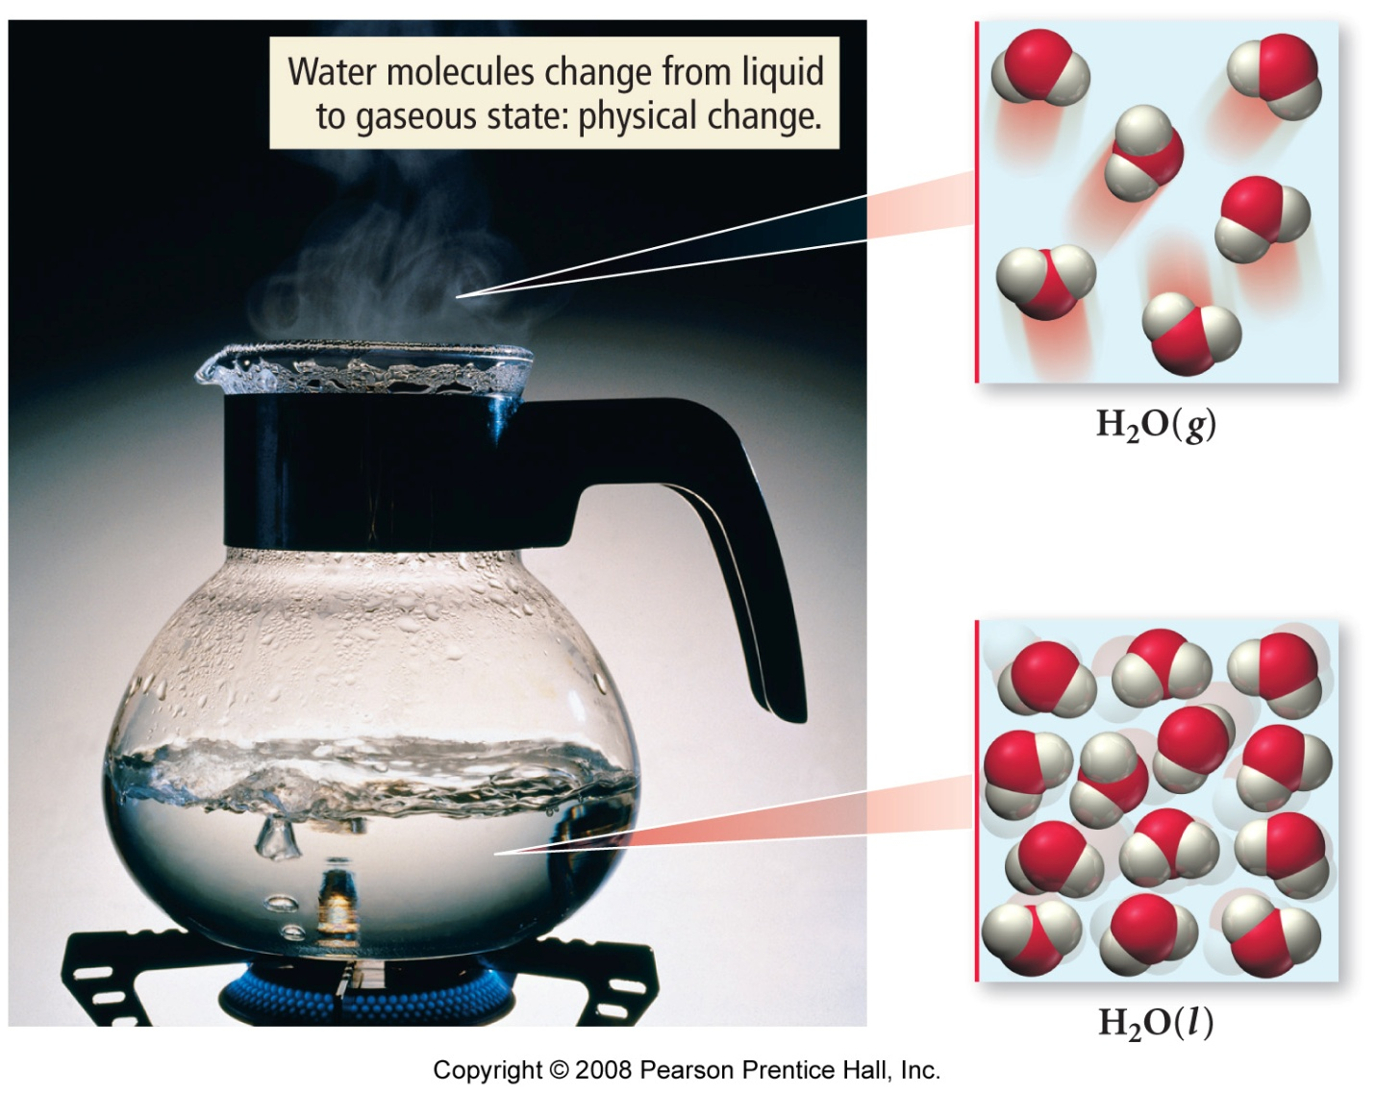
Water boiling – physical change

Slide 12
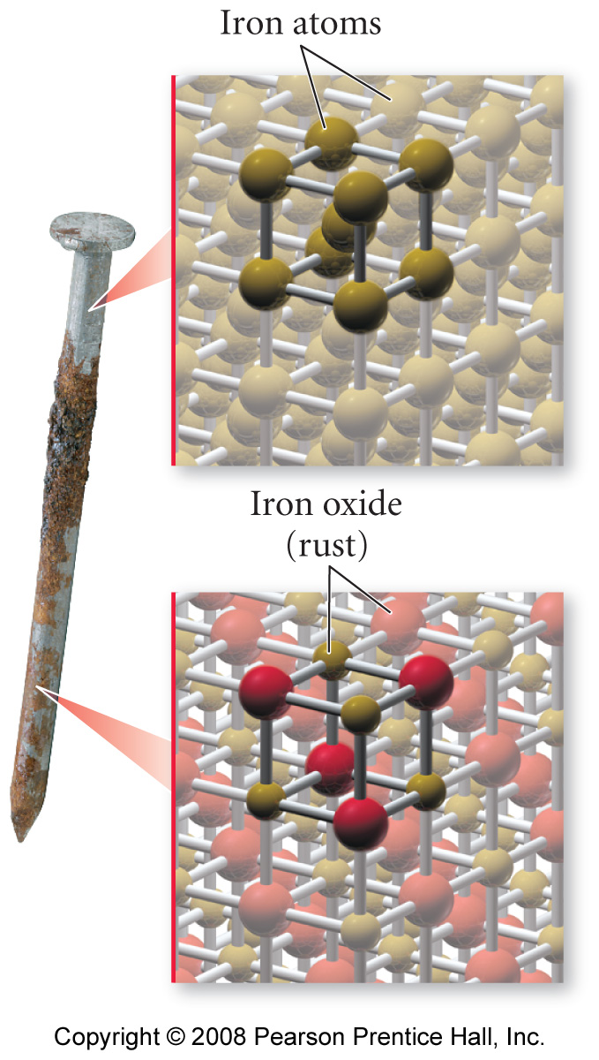
Rust
Chemical change

Slide 13
Why they make you come here
The world is made up of molecules.
If you want to build a bridge, what properties must it have? What properties must its parts have?
Life is about motion and change. What causes the changes? What limits the changes? What could we do to improve the situation?

Slide 14
Questions are more important than answers
Answers are fleeting and specific.
Questions can be asked over and over again.

Slide 15
Chemistry is Questions
As we go through the course, try not to think of all the topics as isolated concepts.
All of our concepts are questions about molecules and their reactions or interactions.
The questions are central to every human pursuit as well as the very existence of life.

Slide 16
Chemistry is about Every Thing
Chemistry is the most practical of sciences. Chemistry is rooted in the investigation of materials (real things) and their properties. As a result, other sciences rely on Chemistry for information about the “things” they study.

Slide 17
Building Blocks of Matter
Chemistry is the study of matter - which is anything that has mass and takes up space. In other words, Matter is ANY-THING.
Matter itself has a wide variety of properties. What these properties are and how these properties can be changed is important to the function of everything from a rock to a human being.

Slide 18
Divisible vs. Indivisible
The world we see around us appears to be quite divisible – it can be divided into pieces of the whole.

Slide 19
Divisible vs. Indivisible
Consider a tree. It’s made of “wood”. But, what is wood?
Chop down a tree, you can make a 2x4 board. A 2x4 is a piece of a tree.
Cut up the 2x4, you can make toothpicks. Toothpicks are pieces of a 2x4 which is a piece of a tree.
Grind up a toothpick, you get sawdust. Sawdust is a piece of a toothpick which is a piece of a 2x4 which is a piece of a tree.
Things in nature are DIVISIBLE! But not infinitely so.

Slide 20
Molecules
A molecule (chemical compound) is the smallest unit of matter that maintains the identity of the parent. For glucose (sugar), the glucose molecule is the smallest unit of sugar that would still taste sweet. For wood, the molecule is cellulose.
Molecules are made up of even smaller units called atoms (elements). An atom is indivisible by any normal chemical or physical means. (To split it, you need to use nuclear means such as a high energy particle accelerator).

Slide 21
Molecules
Chemistry is all about how you arrange and rearrange atoms to make different molecules. Chemistry is also about the physical properties of the molecules themselves.
Biology, Biochemistry, Materials Science, polymer science, engineering, and a wide variety of other disciplines all rely on Chemistry’s ability to create and measure the properties of molecules.

Slide 22
The Chemical vs. The Physical
When we talk about the “physical properties” of materials, we are talking about molecules. Molecules are the smallest, indivisible units of matter that maintains the identity (and most properties) of that matter.
When we talk about the “chemical properties” of materials, we are talking about atoms. Chemistry is often defined as the making or breaking of bonds to rearrange the atoms in a molecule.

Slide 23
What if you have more than 1 type of molecule?
What’s the difference between sugar-water and sugar?
Sugar is dry Sugar-water is wet
Sugar is sweet Sugar-water is sweet
Sugar melts if heated Sugar-water boils

Slide 24
Both have sugar, but…
Sugar (glucose) is a single type of molecule.
Sugar-water is a mixture of sugar molecules and water molecules.
A mixture usually has some properties that are different from either of its substituents. It might also share a few: sugar-water and water are both wet. Sugar-water and sugar are both sweet.
But boiling point of sugar-water is different than the boiling point of sugar and the boiling point of water.

Slide 25
MATTER
CAN YOU PHYSICALLY SEPARATE?
NO
YES
PURE
MIXTURE
Can you
chemically
Separate?
Is it “uniform”
Throughout?
NO
YES
NO
YES
ATOM
(ELEMENT)
MOLECULE
(COMPOUND)
HETEROGENEOUS
HOMOGENEOUS

Slide 26
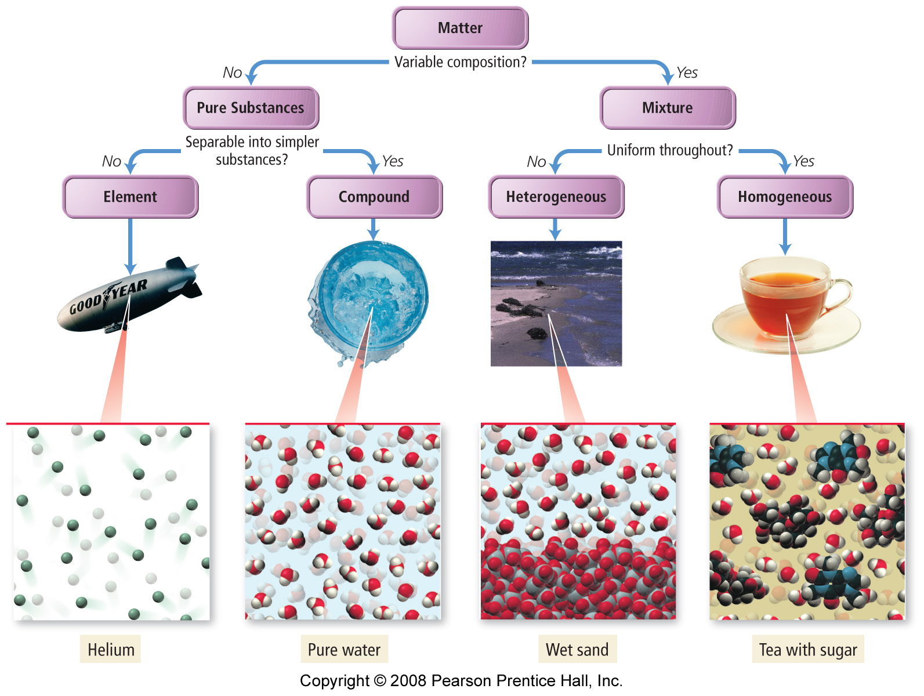

Slide 27
What is it?
Sugar-water
mixture
Made up of water and sugar
Homogenous mixture
Each part of the pitcher is identical: there is some water and some sugar, it is clear and colorless

Slide 28
What is it?
Mayonaisse
mixture
Made up of eggs and oil and water and…???
Homogenous mixture
Each part of it is identical: it is white and smooth

Slide 29
What is it?
Sweet Relish
mixture
Made up of pickles and water and sugar and peppers and corn
Heterogenous mixture
You can see the difference between the pickles and the peppers and between the peppers and the corn.

Slide 30
Questions???
It’s all about being able to ask the questions and then finding the answers.

Slide 32
MATTER
CAN YOU PHYSICALLY SEPARATE?
NO
YES
PURE
MIXTURE
Can you
chemically
Separate?
Is it “uniform”
Throughout?
NO
YES
NO
YES
ATOM
(ELEMENT)
MOLECULE
(COMPOUND)
HETEROGENEOUS
HOMOGENEOUS

Slide 33
Question
Consider a glass of Coke with no ice cubes. It is…
A pure substance
An element
A homogeneous mixture
A heterogeneous mixture

Slide 34
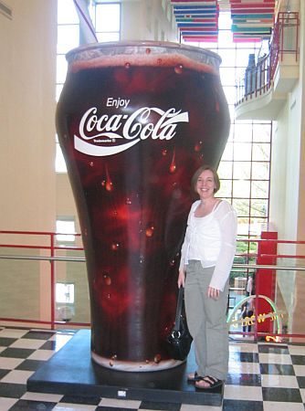

Slide 35
Question
Consider chocolate pudding:
A pure substance
An element
A homogeneous mixture
A heterogeneous mixture

Slide 36
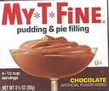

Slide 37


Slide 38
Question
Consider a hamburger:
A pure substance
An element
A homogeneous mixture
A heterogeneous mixture

Slide 39


Slide 40
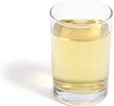
Apple juice

Slide 41
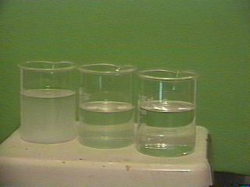

Slide 42
Summary
Chemistry is about every Thing.
“Things” can be pure substance (elements or compounds) or mixtures (heterogeneous or homogeneous)
Chemistry is concerned with the measurement and understanding of the chemical and physical properties of materials.

Slide 43
A word about Energy…
Energy is a difficult concept to define. It is often easier to define it in terms of what it does rather than what it is.
Energy, difficult as it is, is a critical concept underlying the physical sciences because energy provides the impetus for changes.

Slide 44
Energy
Energy is often defined as “the capacity to do work”. So, it is usually the work being done that you see.
Work is “the action of a force through a distance”.
So, if I push a chair 10 feet across the floor. My force (push) acting over a distance (10 feet) is work. The food I eat and its subsequent metabolism provides “capacity to do work” (energy).

Slide 45
Energy = kinetic energy + potential energy
Kinetic energy is energy of motion (my moving chair)
Potential energy is stored energy (food – chemical potential energy)

Slide 46
Conservation of Energy
Energy is neither created nor destroyed, it simply changes form.
So, if I look at a system (collection of things), the total energy (kinetic+potential) should be constant at all times.
The only way to get energy into a system is to do work on it.

Slide 47
Turning Potential into Kinetic

Slide 48
Turning Potential into Kinetic
Kinetic (horizontal bike)
+ potential (height
Kinetic (horizontal bike)
+ kinetic (vertical bike)
+ potential (height)

Slide 49
Turning Potential into Kinetic
Kinetic (horizontal bike)
+ potential (height
potential (height)
+ heat (squash)

Slide 50
At ALL times, the total energy in the system is conserved (remains the same).
Total = kinetic + potential + heat
Heat is actually molecular kinetic energy
If you wanted to change the amount of energy in the system, you’d need to do WORK to add or subtract energy from the system (for example, carry the wrecked bike back up to the roof).

Slide 51
Chemical Energy
We will, at various times, explore the energy changes involved in molecular interactions (sadly, we don’t get to throw things off the building – we leave that to physicists.)
Stored chemical energy is a form of potential energy
Molecular motions are kinetic energy (heat)

