Slide 1
MOLES! MOLES! MOLES!
Joe’s 2nd Rule of Chemistry

Slide 2
Mass in amus
The weighted average isotope mass is what is present in the periodic table.
We saw that it is better to view the units of these “atomic masses” as the number of grams per mole (g/mol) of an atom.

Slide 3
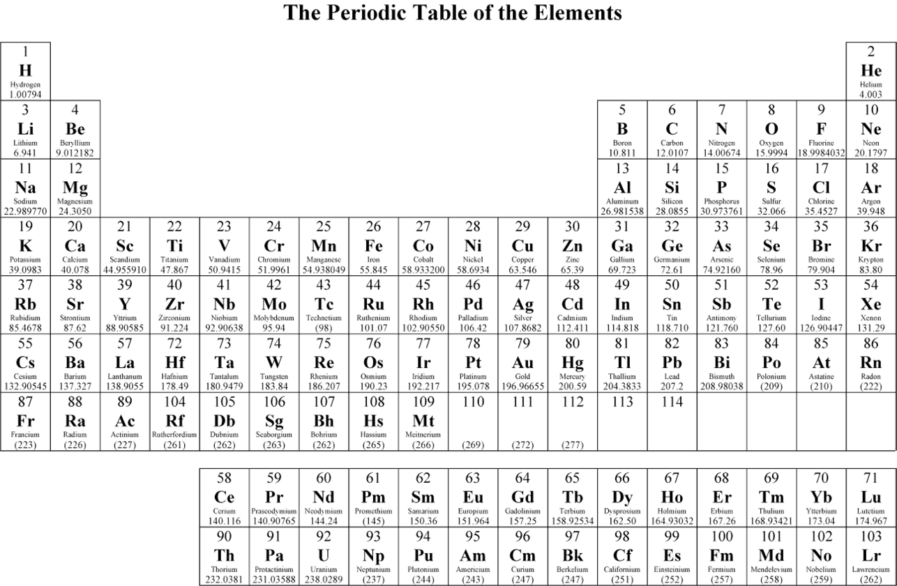

Slide 4
Avogadro’s Number
Carbon has an atomic mass of 12.011 amu.
Nitrogen has an atomic mass of 14.007 amu.
Suppose I have enough carbon atoms so that the sample weighs 12.011 grams.
If I have the same number of nitrogen atoms, it should weigh 14.007 grams.
That number of atoms is called Avogadro’s Number!

Slide 5
Avogadro’s Number
6.022x10²³ particles is the number of particles that makes this work!
If you have 6.022x10²³ atoms of any element, then its mass in grams is the same as its atomic mass in amu.

Slide 6
Call it a mole
12 is a dozen
144 is a gross
500 is a ream
6.022x10²³ is a “mole”.
A mole is just a collection of objects. It doesn’t have to be atoms, it could be anything. If you have 6.022x10²³ of them, you have a mole of them.

Slide 7
6.02214150x10²³ anythings per mole
How many ¹²C atoms in a mole of ¹²C?
6.02214150x10²³
How many ping pong balls in a mole of ping pong balls?
6.02214150x10²³

Slide 8
Avogadro’s number
Just another conversion factor:
6.022x10²³ things
mole

Slide 9
MOLES! MOLES! MOLES!
Chemistry is largely a question of UNITS! UNITS! UNITS! And MOLES! MOLES! MOLES!
If you can grasp the significance of units and moles, this course becomes very simple.

Slide 10
MOLES! MOLES! MOLES!
A mole is just a collection, a way of counting large numbers of things. After all, atoms and molecules are very small; if you have a collection of them that you can see, it has a lot of particles in it!

Slide 11
2Mg + O₂ → 2 MgO
This is a chemical reaction. Magnesium mixed with oxygen yields magnesium oxide (MgO).
2 atoms of Mg combine with 1 molecule of oxygen to form 2 molecules of MgO.

Slide 12
Grams is good, moles is better
The implication of my chemical reaction is that it isn’t the mass of the chemicals that matters, but the number of atoms or molecules. Things react by colliding with other things on a particle (atom or molecule) by particle basis.
If I want to track the chemistry, I need to know how many atoms/molecules are in my sample.

Slide 13
Grams is good, moles is better
Grams is easy to measure – you just throw it on a balance.
Moles is necessary to understand the chemistry.

Slide 14
The Power of 6.022 x 10²³
The key to the power of Avogadro’s number of particles is that it relates the number of particles to a measurable mass.
If you have 6.022x10²³ atoms of carbon, it weighs 12.011 grams.
This means that atomic mass (also called “molar mass”) is best expressed not in “amu”, but the equivalent grams/mole.

Slide 16
1 amu = 1.66053873x10⁻²⁷ kg
Carbon-12 has a mass of 12 amu (by definition)
12 amu = 12 g * 1 mole
mole 6.022x10²³ atoms
12 amu = 1.993 x 10⁻²³ grams
1 amu = 1.66x10⁻²⁴ grams

Slide 17
Sample Problem
I have 36.0 g of carbon, how many moles do I have?
What is the first thing I need to ask myself?
What do I know?
36.0 grams of carbon
What do I need to know?
moles of carbon
What is the conversion factor?
atomic mass or molar mass

Slide 19
The Solution
36.0 g C * 1 mol C = 2.997 mol C
12.011 g C
Molar mass (atomic mass) should be viewed as the conversion factor between mass (grams) and moles!

Slide 20
Sample problem
A 2 oz bag of M&Ms has 30 pieces in it. What is the mass (in g) of 1 mole of M&Ms?

Slide 21
What do I know? What do I actually have?
A 2 oz bag of M&Ms has 30 pieces in it. What is the mass (in g) of 1 mole of M&Ms?

Slide 22
Solution
1 mole M& M * 6.022x10²³ M&Ms * 2 oz * 1 lb * 453.6 g =
1 mol 30 M&Ms 16 oz 1 lb
= 1.138 x 10²⁴ g
=1 x 10²⁴ g (because 2 oz = 30 M&Ms only has 1 sig fig)

Slide 23
Molar Mass
Molar Mass of MgO = Molar mass of Mg + Molar Mass of O
= 24.305 g/mol + 16.000 g/mol
= 40.305 g/mol

Slide 24
Sample Problem
I have 36.45 g of water (H₂O), how many water molecules is that?
1. What do you know?
g of water
2. What do you want to know?
moles of water
3. What do you need to know?
molar mass of water

Slide 25
Sample Problem
I have 36.45 g of water (H₂O), how many moles of water is that?
To get the molar mass of water…
…add up the molar masses of each atom
Molar mass H₂O = 2*mass of hydrogen + 1 mass of oxygen

Slide 27
Sample Problem
I have 36.45 g of water (H₂O), how many moles of water is that?
Molar mass H₂O = 2*mass of hydrogen + 1 mass of oxygen
= 2*(1.00797 g/mol) + 16.000 g/mol
=18.016 g/mol

Slide 28
Solution
I have 36.45 g of water (H₂O), how many moles of water is that?
36.45 g H₂O * 1 mol H₂O = 2.023 mol H₂O
18.016 g H₂O

Slide 30
Very common calculation
We will constantly be calculating the number of moles of chemical compounds. We will see many more examples throughout the course.
Applying the molar mass is the most common calculation, and it is easy to do once you have the chemical formula – H₂O – which indicates the number of each atom.

Slide 31
Solutions – More later, but…
We’ll talk much more about solutions later, but you have encountered it in lab.
Molarity is a unit of “concentration”. It represents how much of a solute is dissolved in a solution.

Slide 32
MOLARITY
UNITS! UNITS! UNITS!
$$Molarity= \frac{moles of solute}{L solution}$$

Slide 33
Example
I dissolve 25 g of NaCl in 500 mL of water. What is the molarity of the resulting solution?
UNITS! UNITS! UNITS!
$$Molarity= \frac{moles of solute}{L solution}$$
So, I need moles of solute (NaCl) and L of solution.

Slide 34
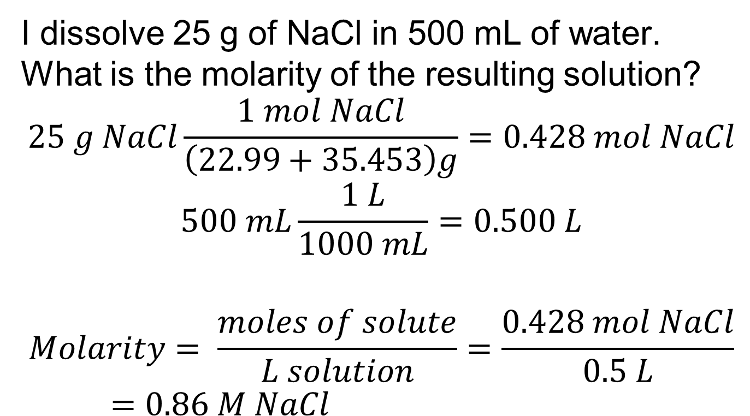
Example
I dissolve 25 g of NaCl in 500 mL of water. What is the molarity of the resulting solution?
$$25 g NaCl\frac{1 mol NaCl}{\left(22.99+35.453\right)g}=0.428 mol NaCl$$
$$500 mL\frac{1 L}{1000 mL}=0.500 L$$
$$Molarity= \frac{moles of solute}{L solution}=\frac{0.428 mol NaCl}{0.5 L}=0.86 M NaCl$$

Slide 35
Molarity is…
…just a conversion factor for a solution. It converts moles of solute to L of solution or vice versa.
So, Molarity is only useful if I either have L of solution or moles of solute

Slide 36
Molarity as a conversion factor
I have 25 mL of 0.100 M NaCl. How much NaCl do I have?
What do I actually have?
25 mL!
$$25 mL\frac{1 L}{1000 mL}=0.025 L$$
$$0.025 L\frac{0.100 moles}{1 L}=0.0025 mol NaCl$$

Slide 37
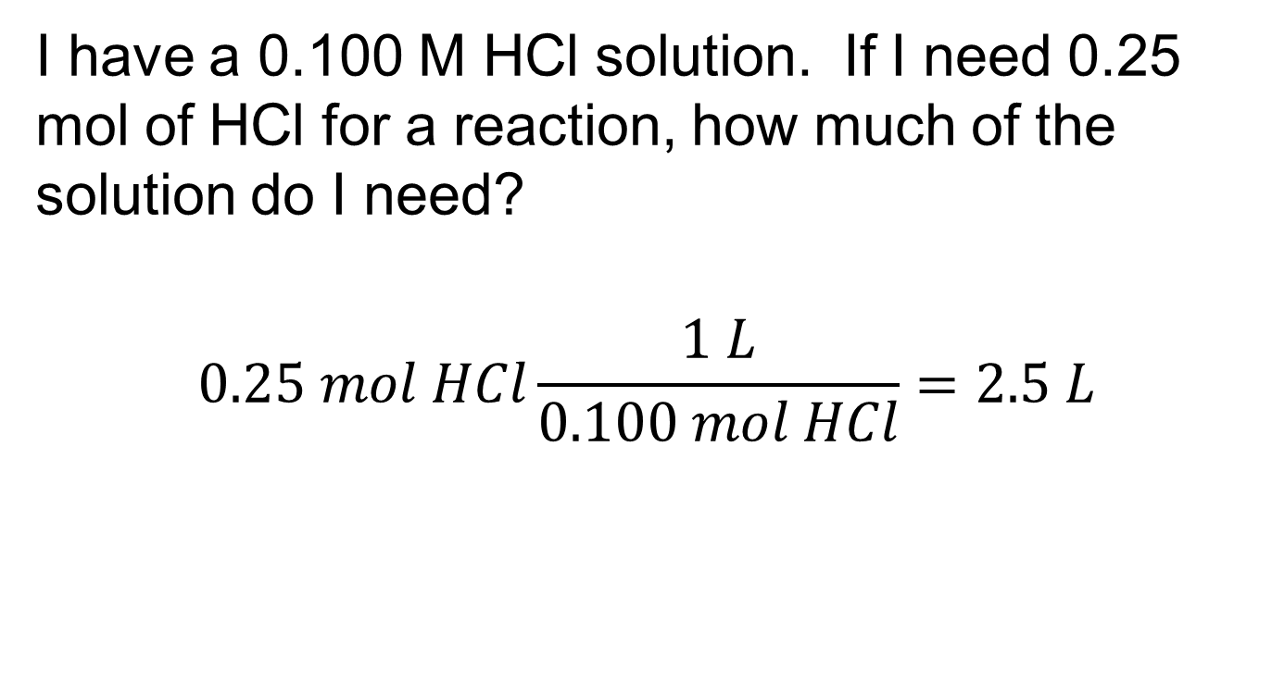
I need some HCl
I have a 0.100 M HCl solution. If I need 0.25 mol of HCl for a reaction, how much of the solution do I need?
$$0.25 mol HCl\frac{1 L}{0.100 mol HCl}=2.5 L$$

