Slide 1
Enthalpy
Calorimetry of Chemistry

Slide 2
Reaction Energies
In our earlier discussions of calorimetry, we used physical sources of heat (hot metal slug). It is also possible to use chemical sources of heat (like hot packs and cold packs).
The energy change associated with a chemical reaction is called the enthalpy of reaction and abbreviated Δ H.

Slide 3
Enthalpy of Reactions
There are actually a number of different types of enthalpies because enthalpy depends on conditions. THEY ARE ALL JUST SPECIFIC TYPES OF A GENERAL CONCEPT CALLED “ENTHALPY”.
ΔH = H_{final} - H_{initial}

Slide 4
General Reaction Scheme
Energy
E_{a}
Reactants
ΔH
Products
Reaction Coordinate

Slide 5
Reaction Coordinate
The “reaction coordinate” is actually complicated to determine, but easy to understand.
The actual energy profile of a reaction is a multi-dimensional curve with lots of different paths from reactants to products.
The reaction coordinate is simply the most common path that averages all of the different parameters: bond length, bond angle, collision frequency, etc.

Slide 6
Exothermic Reaction – “hot pack”
Energy
E_{a}
Reactants
ΔH
Products
Reaction Coordinate

Slide 7
Endothermic Reaction – “cold pack”
Energy
E_{a}
Products
Reactants
ΔH
Reaction Coordinate

Slide 8
Where does the Energy go?
In the case of a chemical reaction, you need to keep the different types of energy separate in your mind:
Bond energy – energy INSIDE the molecules
Thermal energy (heat) – kinetic energy of the molecules
Energy of the “bath” – kinetic energy of solvent or other molecules in the system

Slide 9
Energy changes
ΔH represents the change in INTERNAL MOLECULAR ENERGY.
Δ H = H_{final} - H_{initial}

Slide 10
Exothermic Reaction – “hot pack”
Energy
E_{a}
Reactants
ΔH
Products
Reaction Coordinate

Slide 11
Exothermic energy changes
Δ H = H_{final} – H_{initial} < 0
H_{initial}>H_{final}
This energy is internal to the molecule.
The excess gets absorbed by the rest of the system as heat causing the molecules to move faster (more kinetic energy) and the temperature to increase.

Slide 12
Endothermic Reaction – “cold pack”
Energy
E_{a}
Products
Reactants
ΔH
Reaction Coordinate

Slide 13
Endothermic energy changes
ΔH = H_{final} – H_{initial} > 0
H_{initial}<H_{final}
This energy is internal to the molecule and must come from somewhere.
The additional energy required by the system gets absorbed from the rest of the system as heat causing the molecules to move slower (less kinetic energy) and the temperature to decrease.

Slide 14
Clicker Question
Consider the following reaction:
2 H_{2 (g)} + O_{2 (g)}  2 H₂O _{(g)}
If Δ H_{rxn} < 0, it means:
The products have less energy than the reactants – you could make a hot pack.
The reactants have less energy than the products – you could make a cold pack.
The products have less energy than the reactants – you could make a cold pack.
The reactants have less energy than the products – you could make a hot pack.

Slide 15
The hard part is getting over the hump.
Energy
E_{a}
Products
Reactants
ΔH
Reaction Coordinate

Slide 16
E_{a} = Activation Energy
The tale of a reaction is not limited strictly to the identity and energetics of the products and reactants, there is a path (reaction coordinate) that must get followed.
The “hump” represents a hurdle that must be overcome to go from reactants to products.

Slide 17
How do you get over the hump?
If you are at the top, it is easy to fall down into the valley (on either side), but how do you get to the top?
Energy
E_{a}
Products
Reactants
ΔH
Reaction Coordinate

Slide 18
How do you get over the hump?
The molecules acquire or lose energy the same way: by colliding with each other!
The energy comes from the “bath”, the rest of the system.
Energy
E_{a}
Products
Reactants
ΔH
Reaction Coordinate

Slide 19
Types of ΔH
Δ H – generic version
Δ H_{rxn} – generic version
Δ Hº - enthalpy change under Standard Temperature and Pressure (298 K, 1 atm)
Δ H_{f} – enthalpy of formation, refers to a specific reaction type
Δ H_{comb} – enthalpy change of combustion
Δ H⁰_{f} – enthalpy of formation at STP

Slide 20
Start here

Slide 21
2 H_{2 (g)} + O_{2 (g)}  2 H₂O_{(g)}
The enthalpy change involved in this reaction depends, to some extent, on conditions.
At STP, Δ H⁰ will be known if it’s ever been measured:
Δ H⁰ = -483.66 kJ
The enthalpy change must include some accounting for the amount (moles of the substance)

Slide 22
2 H_{2 (g)} + O_{2 (g)}  2 H₂O_{(g)}
This reaction is a very special type of reaction.
This is a reaction of formation.
A formation reaction creates a molecule from the most common elemental form of its constituent atoms
Δ H_{f}⁰ = -241.83 kJ/mol
We form 2 moles of H₂O in this reaction, so:
Δ H_{rxn} = 2 mol*(-241.83 kJ/mol) = -483.66 kJ

Slide 23
Determining the ΔH
Where did I get that number (Δ H_{f}⁰ = -241.83 kJ/mol)?
From the table in the appendix of your book which lists enthalpies of formation for a number of different molecules!

Slide 24
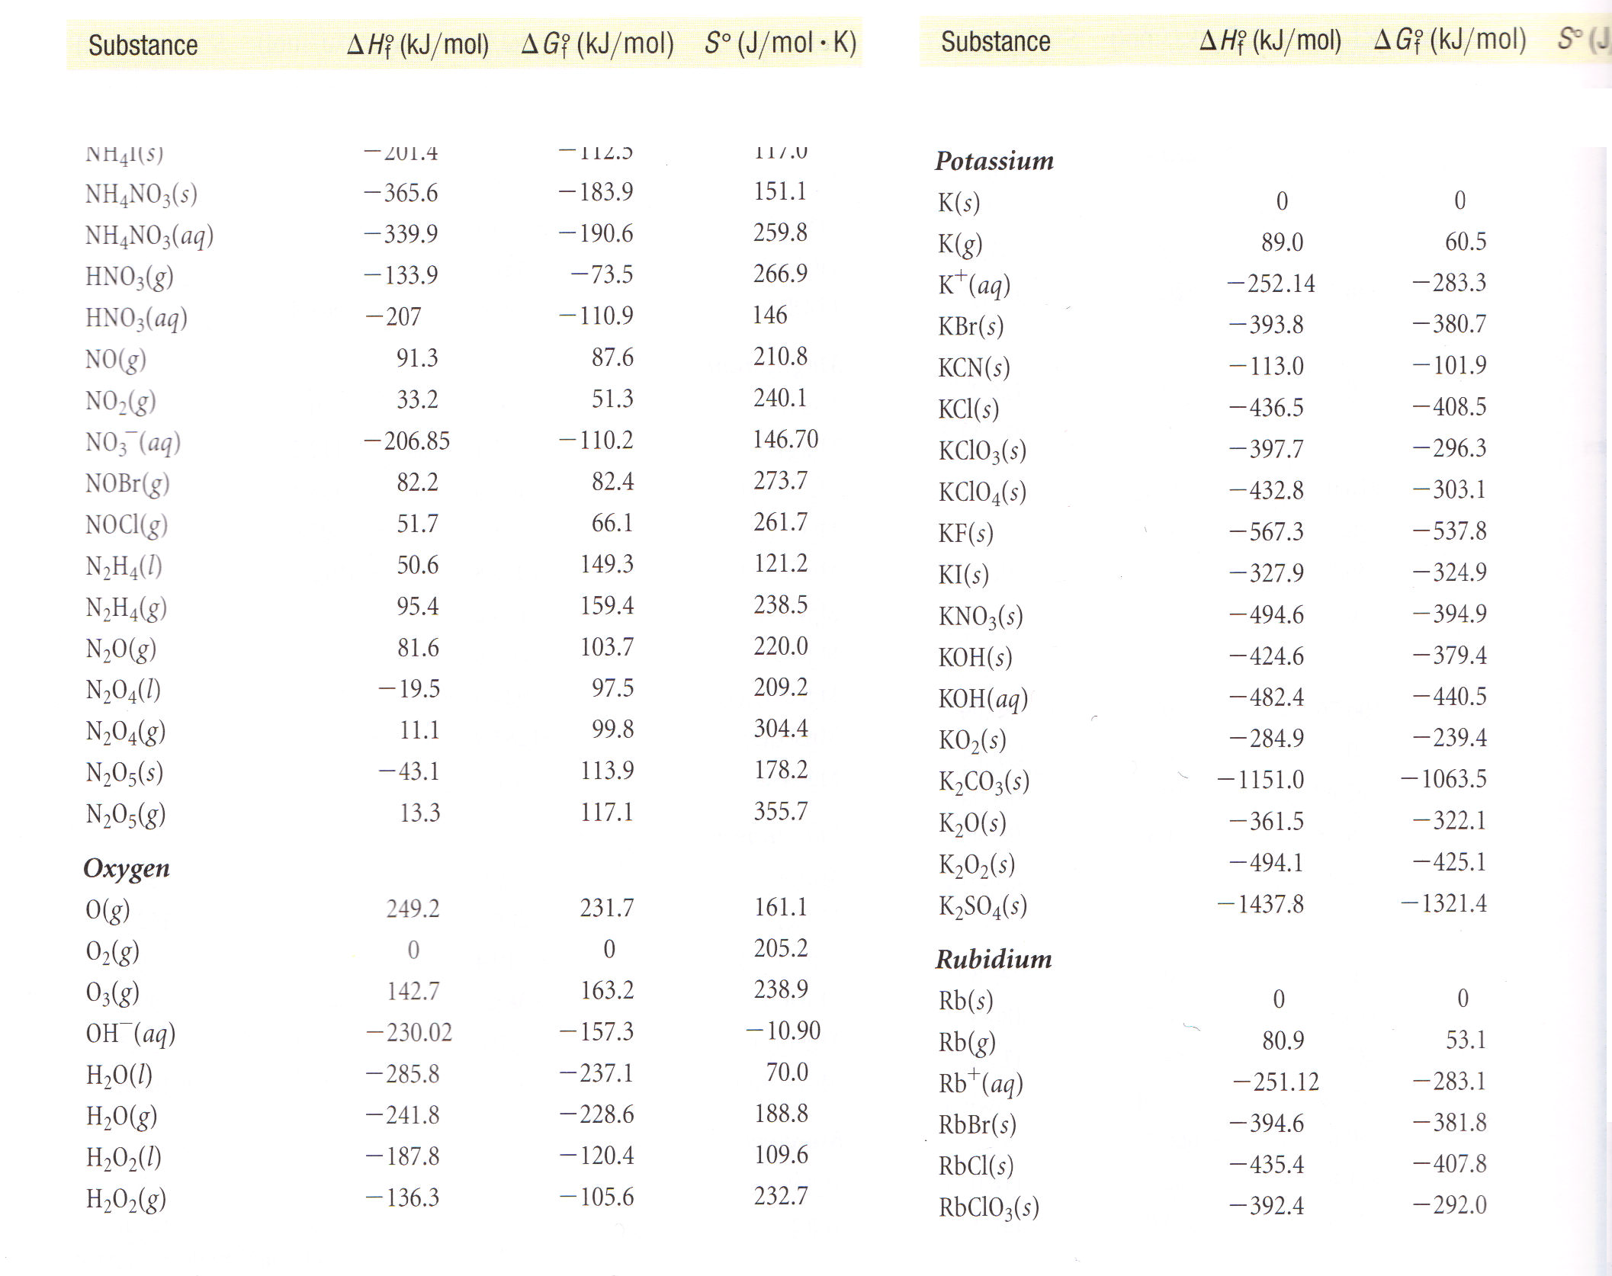

Slide 25
Determining the ΔH
Suppose the molecule you care about isn’t in that table?
Find a different table! ☺
Half-kidding! You could also determine the value from the bond energies involved.

Slide 26
Enthalpy is a “State Function”
What’s a “state function”?
A “state function” is a value that is a function only of the initial and final states of the system, not the path you take to get there!

Slide 27

Climbing Mt. Everest
Suppose you start at Himalayan Base Camp #1, climb to the summit of Everest over the course of 3 weeks, then return to Himalayan Base Camp #1.

Slide 28
Climbing Mt. Everest
Back at base camp, I figure out my altitude change. What is it?
ZERO – I’m back where I started

Slide 29
Climbing Mt. Everest
I did a lot of work along the way, but all that matters is I’m back where I started. The net change in altitude is NADA, ZERO, ZILCH!

Slide 30
Enthalpy as a State Function
Enthalpy is like that. It doesn’t care how you got where you are going, it simply looks at the difference from where you started.

Slide 31
Path doesn’t matter!
Actual path
H
Products
Reactants

Slide 32
2 H_{2 (g)} + O_{2 (g)}  2 H₂O_{(g)}
We don’t know exactly how this reaction occurs:
2 H₂ collide forming 4 H fragments, then 1 H fragment collides with the O₂ creating an OH and an O, then the O collides with an H to make a second OH, then the two OH collide to make H₂O and another O which then collides with an H…
2 H₂ and 1 O₂ all collide at the same time creating 2 H₂O molecules

Slide 33
2 H_{2 (g)} + O_{2 (g)}  2 H₂O_{(g)}
IT JUST DOESN’T MATTER

Slide 34
2 H_{2 (g)} + O_{2 (g)}  2 H₂O_{(g)}
You can pick whatever path you want that makes it easy to calculate.

Slide 35
2 H_{2 (g)} + O_{2 (g)}  2 H₂O _{(g)}
H-H H H H H
H-H  \ / \ /
O=O O O
One common path: add up all the broken bonds and the made bonds and see what the net difference is!

Slide 36
2 H_{2 (g)} + O_{2 (g)}  2 H₂O _{(g)}
H-H H H H H
H-H  \ / \ /
O=O O O
I need to break 2 H-H bonds and 1 O=O bond
I need to make 4 O-H bonds

Slide 37
2 H_{2 (g)} + O_{2 (g)}  2 H₂O_{(g)}
Bond Dissociation Energies – energy required to break a bond
Δ H_{rxn} = H_{final} - H_{initial}
Δ H_{rxn} = energy put in to break bonds – energy regained from bonds formed
Δ H_{rxn} = Σbonds broken - Σ bonds formed

Slide 38
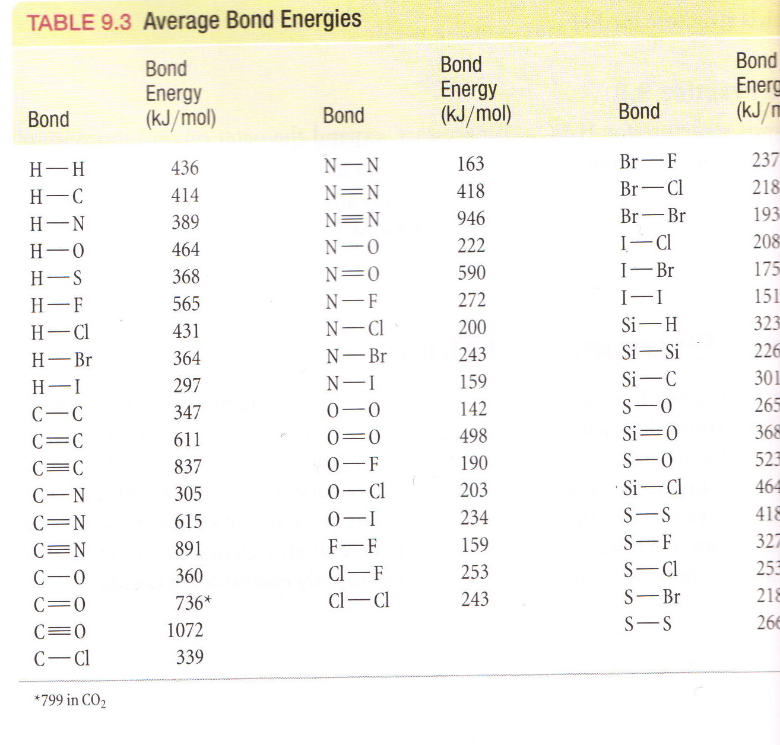

Slide 39
2 H_{2 (g)} + O_{2 (g)}  2 H₂O_{(g)}
From Table in your book (page 392)
H-H BDE is 436 kJ/mol
O=O BDE is 498 kJ/mol
O-H BDE is 463 kJ/mol
Δ H_{rxn} = Σbonds broken - Σbonds formed
Δ H_{rxn} = [2*H-H + 1*O=O) – (4*O-H)]
Δ H_{rxn} = [2*436+ 1*498) – (4*463)] = -482 kJ

Slide 41
2 H_{2 (g)} + O_{2 (g)}  2 H₂O_{(g)}
Previously, we found: Δ H_{f}⁰=-483.66 kJ
Calculated from Bond Dissociation Energies, Δ H_{rxn} = -482 kJ

Slide 42
Are these the same?
Yes
No
What do you mean by the same?
Assuming that the electron induction of neighboring plasmidogenesis can be accepted, they are.
To the extent that orbital influence of neighboring groups cannot be ignored, they are not.
Turkeyyy….mmmmmmmmmmm

Slide 43
2 H_{2 (g)} + O_{2 (g)}  2 H₂O_{(g)}
This compares well to the known value given earlier: Δ H⁰=-483.66 kJ
Calculated from Bond Dissociation Energies, Δ H_{rxn} = -482 kJ
Why the slight difference?
Bond energies are not identical, depending on who their neighbors are: an O-H next to another O-H isn’t exactly the same as an O-H next to an O-N, for example.

Slide 44
Ways to determine Δ H
Find Δ H⁰ in a table
Find Δ H_{f}⁰ in a table
Calculate from Bond Energies
And…
Calculate from Δ H_{f}⁰
Calculate from other Δ H that you already know (Hess’s Law)

Slide 45
2 H_{2 (g)} + O_{2 (g)}  2 H₂O_{(g)}
This is a reaction of formation so we simply found the value for it in the table.
Δ H_{f}⁰ = -241.83 kJ/mol
But even if the reaction of interest isn’t itself a formation reaction, we can still use the enthalpies of formation to get the Δ H_{rxn}

Slide 46
CH_{4 (g)} + 4 Cl_{2 (g)}  CCl_{4 (l)} + 4 HCl _{(g)}
This is not, itself, a formation reaction.
BUT remember ΔH is a STATE FUNCTION
What does that mean?
Δ H doesn’t depend on the path, just the start and the end.

Slide 47
CH_{4 (g)} + 4 Cl_{2 (g)}  CCl_{4 (l)} + 4 HCl _{(g)}
4 Cl₂
4HCl_{(g)}
CH₄
CCl_{4(l)}
All the elements known to mankind!

Slide 48
CH_{4 (g)} + 4 Cl_{2 (g)}  CCl_{4 (l)} + 4 HCl _{(g)}
How does that help?
You can take the long road. Don’t do the reaction as written, take a convenient path that you know the value of each step.

Slide 49
CH_{4 (g)} + 4 Cl_{2 (g)}  CCl_{4 (l)} + 4 HCl _{(g)}
Can you think of a path where you know the value of each step?
Make the products from elements (formation reactions). Make the reactants from elements (formation reactions). The difference between the ΔH_{f}⁰ of the products and the reactants must be the ΔH⁰_{rxn}

Slide 50
CH_{4 (g)} + 4 Cl_{2 (g)}  CCl_{4 (l)} + 4 HCl _{(g)}
4 Cl₂
4HCl_{(g)}
CH₄
CCl_{4(l)}
All the elements known to mankind!

Slide 51
CH_{4 (g)} + 4 Cl_{2 (g)}  CCl_{4 (l)} + 4 HCl _{(g)}
CH₄ (g)
+ 4 Cl₂(g)
Δ H
CCl_{4(l)}
+ 4 HCl_{(g)}
CH₄
CCl₄(l)
All the elements known to mankind!

Slide 52
CH_{4 (g)} + 4 Cl_{2 (g)}  CCl_{4 (l)} + 4 HCl _{(g)}
Δ H⁰_{rxn} = Σ Δ H_{f, prod} - Σ Δ H_{f, react}
Δ H⁰_{rxn} = [Δ H_{f}(CCl₄) + 4* Δ H_{f}(HCl)] –
[Δ H_{f}(CH₄) + 4* Δ H_{f}(Cl₂)]
Δ H⁰_{rxn} = [-139.3 kJ/mol + 4*(-92.3 kJ/mol)]– [-74.8 kJ/mol + 4* 0 kJmol]
H⁰_{rxn} = -433.7 kJ
Δanything = final anything – initial anything

Slide 53
Delta H_{f} (HCl)
½ H₂ (g) + ½ Cl₂ (g) = HCl (g)

Slide 54
CH_{4 (g)} + 4 Cl_{2 (g)}  CCl_{4 (l)} + 4 HCl _{(g)}
Δ H⁰_{rxn} = Σ Δ H_{f, prod} - Σ Δ H_{f, react}
Δ H⁰_{rxn} = [Δ H_{f}(CCl₄) + 4* Δ H_{f}(HCl)] –
[Δ H_{f}(CH₄) + 4* Δ H_{f}(Cl₂)]
Δ H⁰_{rxn} = [-139.3 kJ/mol + 4*(-92.3 kJ/mol)]– [-74.8 kJ/mol + 4* 0 kJmol]
H⁰_{rxn} = -433.7 kJ
-433.7 kJ/mol CH₄
-433.7 kJ/4 mol Cl₂

Slide 55
H_{f}(CCl₄)=-139.3 kJ/mol
If I make 1 mol CCl4, I get/need 139.3 kJ?
A. Get
B. Need

Slide 57
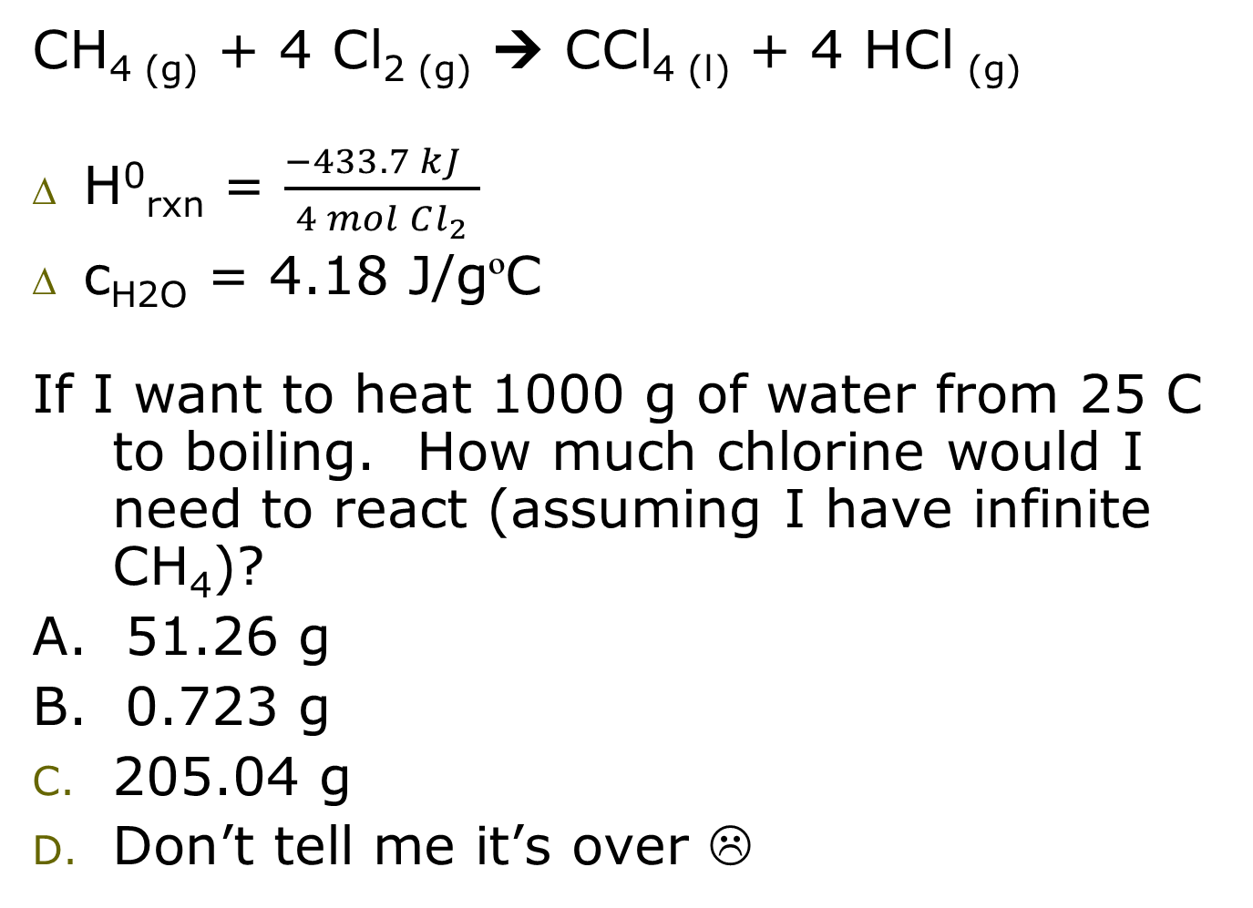
Clicker Question
CH_{4 (g)} + 4 Cl_{2 (g)}  CCl_{4 (l)} + 4 HCl _{(g)}
H⁰_{rxn} = $\frac{−433.7 kJ }{4 mol Cl_{2}}$
c_{H2O} = 4.18 J/gºC
If I want to heat 1000 g of water from 25 C to boiling. How much chlorine would I need to react (assuming I have infinite CH₄)?
A. 51.26 g
B. 0.723 g
205.04 g
Don’t tell me it’s over ☹

Slide 58
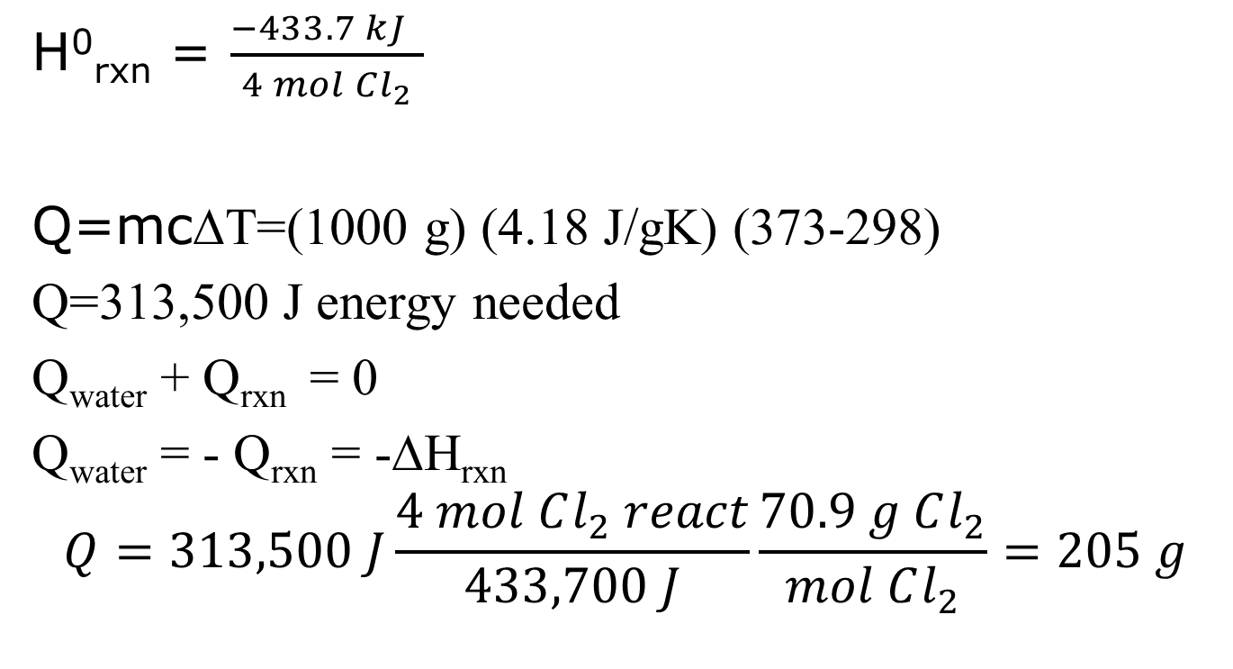
H⁰_{rxn} = $\frac{−433.7 kJ }{4 mol Cl_{2}}$
Q=mc∆T=(1000 g) (4.18 J/gK) (373-298)
Q=313,500 J energy needed
Q_{water} + Q_{rxn} = 0
Q_{water} = - Q_{rxn} = -∆H_{rxn}
$$Q=313,500 J\frac{4 mol Cl_{2} react}{433,700 J}\frac{70.9 g Cl_{2}}{mol Cl_{2}}=205 g$$

Slide 59
Ways to determine Δ H
Find Δ H⁰ in a table
Find Δ H_{f}⁰ in a table
Calculate from Bond Energies
Calculate from Δ H_{f}⁰
Calculate from other Δ H that you already know (Hess’s Law)

Slide 60
Hess’s Law
We already basically used Hess’s Law when we added together the heats of formation
Hess’s Law is simply the tools that go with enthalpy being a state function.

Slide 61
Hess’s Law
If you add two reactions together, Δ H adds together.
If you subtract two reactions, Δ H gets subtracted.
If you reverse a reaction, Δ H changes sign.
If you multiply or divide a reaction, Δ H gets multiplied or divided.

Slide 62
Sample Hess’s Law Problem
Calculate the enthalpy change for the reaction
P₄O_{6 (s)} + 2 O_{2 (g)}  P₄O_{10 (s)}
given the following enthalpies of reaction:
P₄ _{(s)} + 3 O_{2 (g)}  P₄O_{6 (s)} ΔH =-1640.1 kJ
P_{4 (s)} + 5 O_{2 (g)}  P₄O_{10 (s)} Δ H =-2940.1 kJ

Slide 63
Sample Hess’s Law Problem
P₄O_{6 (s)} + 2 O_{2 (g)}  P₄O_{10 (s)}
P₄ _{(s)} + 3 O_{2 (g)}  P₄O_{6 (s)} ΔH =-1640.1 kJ
P₄O_{6 (s)}  P₄ _{(s)} + 3 O_{2 (g)} Δ H =+1640.1 kJ
₊ P_{4 (s)} + 5 O_{2 (g)}  P₄O_{10 (s)} Δ H =-2940.1 kJ
P₄O_{6 (s)} + P_{4(s)} + 5 O_{2 (g)}P₄ _{(s)} + 3 O_{2 (g)} + P₄O_{10 (s)}
Δ H =-1300 kJ

Slide 64
Enthalpy & Calorimetry
You can combine the enthalpies of reaction with the calorimetry we discussed earlier, using the reactions to generate the heat.
This is nothing new, just a combination of the two concepts we already discussed and a few things we knew from before.

Slide 65
2 H_{2 (g)} + O_{2 (g)}  2 H₂O_{(g)}
A bomb calorimeter is a water calorimeter with a small chamber inside in which combustion reactions can be executed. If I put 1 mole of hydrogen and 1 mole of oxygen in a bomb calorimeter containing 1 L of water at 25 ºC, what will the temperature of the water be after ignition? The empty (no water) calorimeter has a specific heat capacity of 145.1 J/ºC.

Slide 66
Q=mc (delta T)
S_{h} =145.1 J/ºC
c = 4.18 J/g ºC

Slide 67
2 H_{2 (g)} + O_{2 (g)}  2 H₂O_{(g)}
A bomb calorimeter is a water calorimeter with a small chamber inside in which combustion reactions can be executed. If I put 1 mole of hydrogen and 1 mole of oxygen in a bomb calorimeter containing 1 L of water at 25 ºC, what will the temperature of the water be after ignition? The empty (no water) calorimeter has a specific heat capacity of 145.1 J/ºC.
What the heck does that mean?
UNITS! UNITS! UNITS

Slide 68
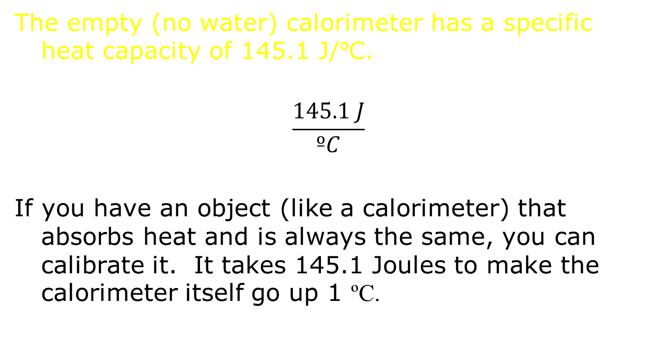
2 H_{2 (g)} + O_{2 (g)}  2 H₂O_{(g)}

Slide 69
2 H_{2 (g)} + O_{2 (g)}  2 H₂O_{(g)}
A bomb calorimeter is a water calorimeter with a small chamber inside in which combustion reactions can be executed. If I put 1 mole of hydrogen and 1 mole of oxygen in a bomb calorimeter containing 1 L of water at 25 ºC, what will the temperature of the water be after ignition? The empty (no water) calorimeter has a specific heat capacity of 145.1 J/ºC.
q_{H2O} = m c ΔT
q_{calorimeter} = m c ΔT
Q = S_{h} ΔT S_{h is} a combination of m’s and c’s.

Slide 70
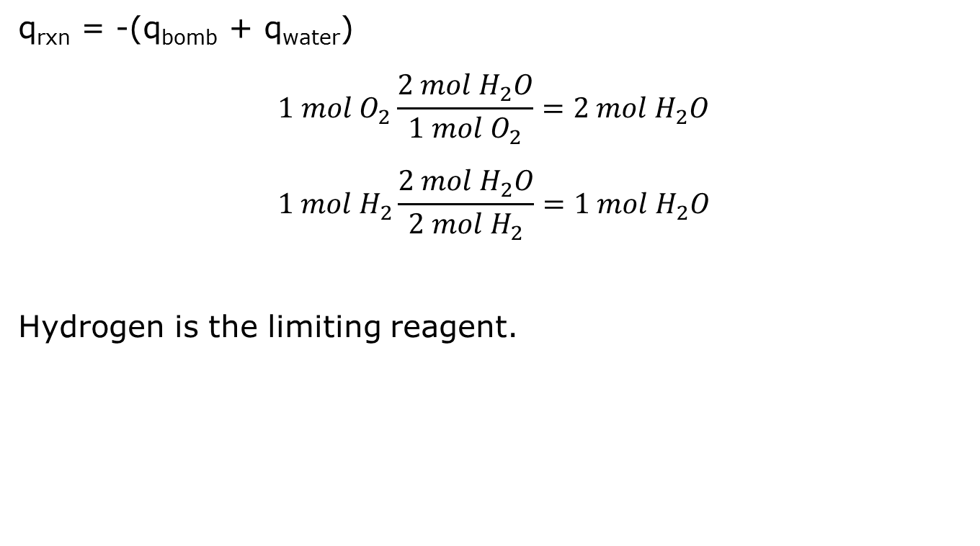
2 H_{2 (g)} + O_{2 (g)}  2 H₂O_{(g)}

Slide 71
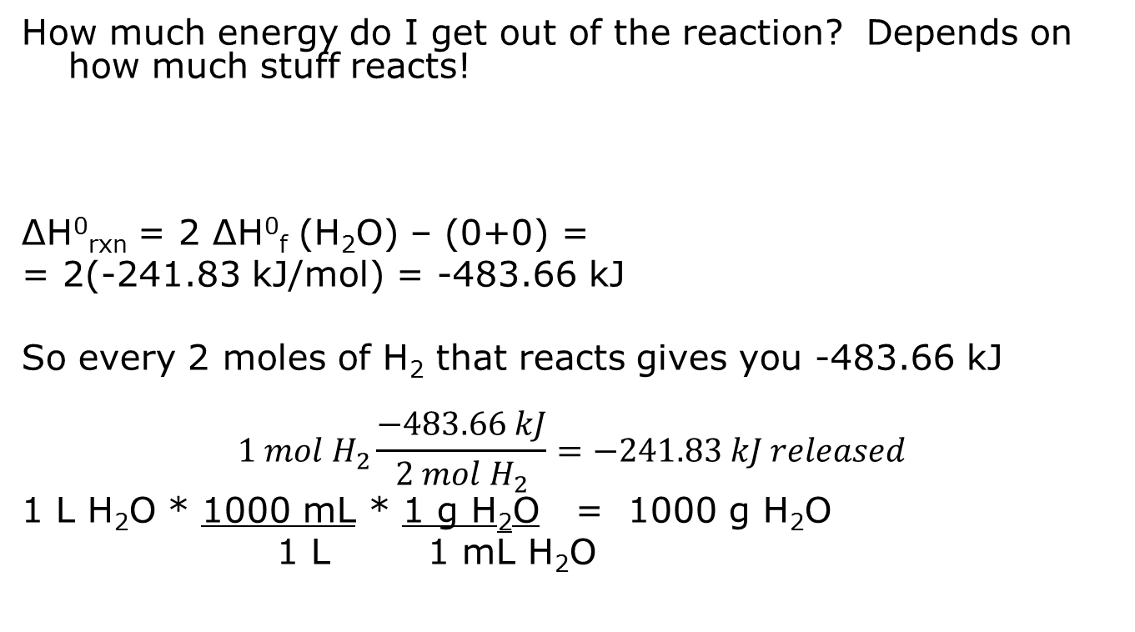
2 H_{2 (g)} + O_{2 (g)}  2 H₂O_{(g)}

Slide 72
2 H_{2 (g)} + O_{2 (g)}  2 H₂O_{(g)}
q_{rxn} = -(q_{bomb} + q_{water})
-241.83 kJ = - (S`_{bomb} Δ T + m_{H2O}c_{H2O} Δ T )
-241.83 kJ=-(145.1 J/ºC ΔT+1000 g*4.18 J/gºC ΔT)
-241.83 kJ = - (4325.1 J/ºC Δ T )
-241.83 x 10³ J = -4325.1 J/ºC Δ T
55.9 = Δ T = T_{f} – T_{i} = T_{f} – 25 ºC
T_{f} = 80.9 ºC

Slide 73
Clicker Question
Given the following:
2 Fe(s) + 3/2 O₂ (g) Fe₂O₃(s) ΔH = -824.2 kJ
CO(g) + ½ O₂ (g) CO₂ (g) ΔH = -282.7 kJ
What is the ΔH_{rxn} for the following reaction:
Fe₂O₃ (s) + 3 CO (g) 2 Fe(s) + 3 CO₂
A. -1106.9 kJ
B. -541.5 kJ
C. -1672.3 kJ
D. -23.90 kJ
E. 541.5 kJ

Slide 74
Clicker Question
Iron can be reacted with nitrogen to yield iron nitride in the reaction:
3 Fe (s) + N₂(g)  Fe₃N₂(s)
10.0 g Fe and 2.00 g N₂ are placed in a calorimeter at 25.0°C and the reaction triggered. The heat capacity of the calorimeter (INCLUDING WATER) is 14.7 kJ/°C. If the final temperature of the calorimeter is 21.2°C, what is the ΔH of the reaction?
A. 55.9 kJ/mol
B. -55.9 kJ/mol
C. 782. kJ/mol
D. 936 kJ/mol
E. -936 kJ/mol

Slide 75
Clicker Question
Iron can be reacted with nitrogen to yield iron nitride in the reaction:
3 Fe (s) + N₂(g)  Fe₃N₂(s)
10.0 g Fe and 2.00 g N₂ are placed in a 2.00 L flask that was initially at STP (before adding the reactants). The reaction was initiated. If the final temperature of the flask is 25°C, what is the final pressure in the flask?
A. 0.14 atm
B. 1.14 atm
C. 1.23 atm
D. 1.8 atm
E. 0.8 atm

Slide 76
Clicker Question
10.0g Fe (1 mol/55.85 g) = 0.179 mol
2.00 g N₂(1 mol/28.014 g) = 0.0714 mol
3 Fe (s) + N₂(g)  Fe₃N₂(s)
I 0.179 mol 0.0714 mol 0
C - 3x -x +x
E
0.179 mol – 3x = 0
x = 0.0597
0.0714-x = 0
x = 0.0714

Slide 77
Clicker Question
10.0g Fe (1 mol/55.85 g) = 0.179 mol
2.00 g N₂(1 mol/28.014 g) = 0.0714 mol
3 Fe (s) + N₂(g)  Fe₃N₂(s)
I 0.179 mol 0.0714 mol 0
C - 3x -0.0597 +0.0597
E 0 0.0117 0.0597
Only the N₂ causes pressure
P = nRT/V = 0.0117 mol*0.08206*298K/2
P = 0.143 atm

Slide 78
P/T = nR/V = constant
1 atm/273 K = x atm/298K
x = 1.09 atm
Total pressure = 1.09 atm + 0.14 atm
= 1.23 atm

