Slide 1
Chemistry & The Ways YOU Learn

Slide 2
Johnstone, A.H.; J. Chem. Ed.; 87,1; pp.22-29 (2010)
Let me ask you a question:
You went shopping. You always buy twice as many shirts as pants. You bought 4 pants. How many shirts did you buy?
1
2
4
8

Slide 3
Congratulations, you know how to do stoichiometry!!
The problem is, if I ask you the same basic question about magnesium and chlorine, the results are not as good – even though it’s the same question!

Slide 4
You could think of most subjects as a triangle
Macroscopic and tangible
Composition and invisible
Symbolic and/or mathematical

Slide 5

4 legs
2 ears
Fur
Mouth
Liver
2 lungs
Etc.
DOG

Slide 6
4 legs
2 ears
Fur
Mouth
Liver
2 lungs
Etc.
The dog was missing one leg and one ear.
DOG
For “everyday” objects and activities, we learn to navigate the triangle without any conscious thought. If I simply say or write “dog”, you each conjure up some image and understanding based on your previous experience.

Slide 7


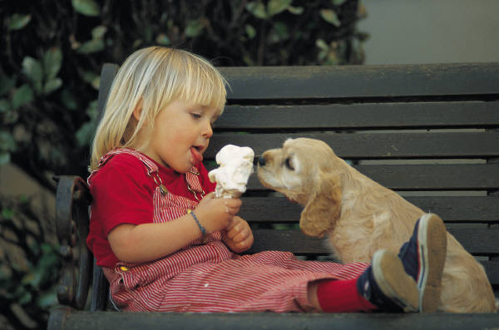

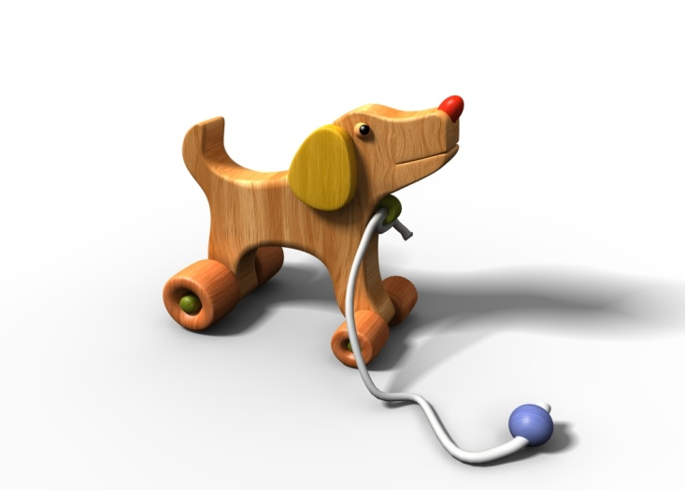
DOG

Slide 8
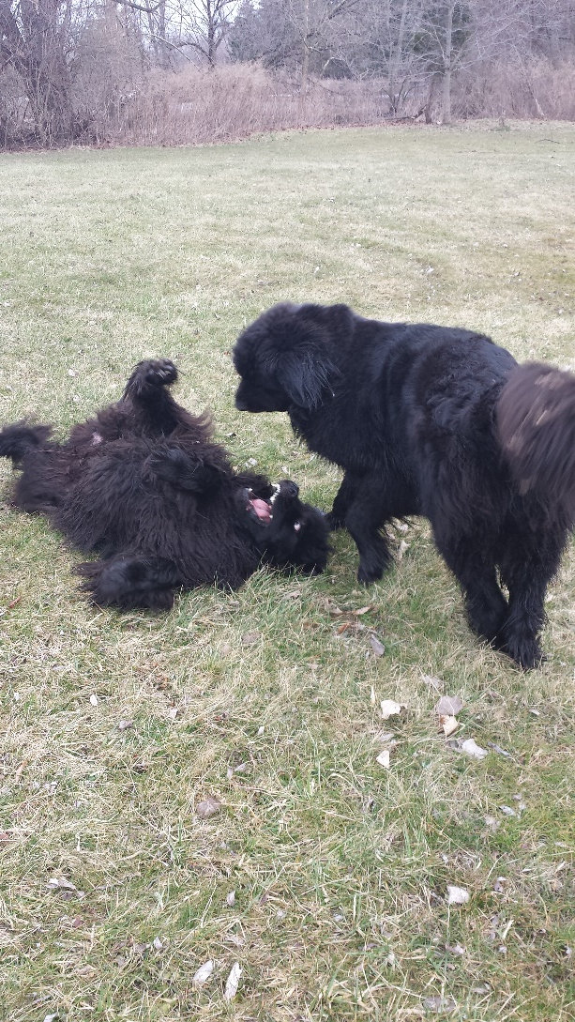
My PERFECT Dogs

Slide 9
Your “Perception Filter”
Your experience creates a “perception filter” which influences how you interpret information.
DOG = Unconditional love
DOG = warm, fuzzy puppy
DOG = KILLER! KILLER! KILLER!
This changes how you view and even solve a problem.

Slide 10
Information Processing
Something new gets filtered by your previous experience. You use what you “know” and use it to
“process” the new idea. This creates new “memory” which changes how you filter ideas in the future.
Ideas
Events
Concepts
Perception
Filter
Holding
Processing
Long term Memory
Filter Control

Slide 11

Information Processing
I know, a silly example, but…
DOG = KILLER!!!
SAVE THE GIRL!!!
Beat the cocker with a stick until dead.
What I know about killing cocker spaniels.
Filter Control

Slide 12
Information Processing
I know, a silly example, but…
DOG = LOVE!
Smile at the girl…until the police come and ask the big bald guy to move along.
I recall my first pet.
Filter Control

Slide 13
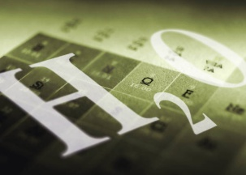
Information Processing
Your attitude, as part of your perception filter, can really affect your ability to solve a problem and learn something new.
CHEM
SUCKS!
CHEM IS HARD!
Stare at problem and doodle on test paper until big bald guy yells “TIME!”
I recall nothing!
Filter Control

Slide 14
Information Processing
Your attitude, as part of your perception filter, can really affect your ability to solve a problem and learn something new.
CHEM
SUCKS!
But I’ve seen this before.
I divide by the molar mass…I think…then maybe I multiply by 2…then…
I recall something about moles. Periodic table. Reaction
Filter Control

Slide 15
Good attitude or bad attitude.
You still have to learn to “speak” Chemistry.

Slide 16
For chemistry
Macroscopic and tangible
Molecular and invisible
Symbolic and mathematical

Slide 17
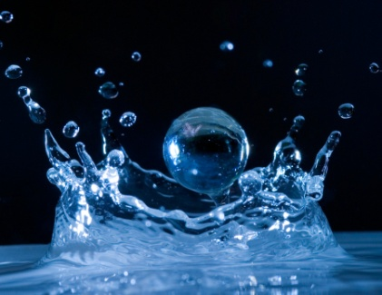
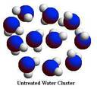


Slide 18
Get friendly with the molecules
The challenge to novices in Chemistry is to learn to move around the triangle.
We use symbols to represent actual molecules. The molecules and their interactions create the chemical principles.
But we’re only used to seeing the macroscopic object: water, sugar, salt, soda.
We need to learn to associate the symbols with the actual molecules and the macroscopic objects. Then Chemistry starts to make common sense.

Slide 19
Students learn to cope…
…that’s not the same as learning.
Developing real understanding requires more effort, and deeper integration of concepts in your mind.
It’s quicker and easier to just learn to cope: “I divide by 2”. But it is better to know WHY you divide by 2 so you aren’t confused when you are actually supposed to divide by 3 or multiply by 2.

Slide 20
It is all on YOU…
No one has ever truly “taught” anything.
“Teach” is not an activity.
I can dance up here all day, show you pretty pictures, solve 1000 problems and at the end of the day…you’ve watched 125 YouTube videos.

Slide 21
Learning is ACTIVE…
Teaching is irrelevant.
Teachers are resources. No different than your text book or the internet. The only advantage I have over your textbook is that I can actually talk with you. (Some of you will consider that a disadvantage.)
Learning is what we do. Learning is all on you.

Slide 22
So I’ve shown you the triangle. I’ve shown you a model for learning. But YOU have to learn to navigate the triangle.
If I write H₂O – I know what it means to me! It has to mean something to you.
Our success or failure will ultimately depend on how well we communicate.

Slide 23
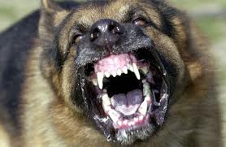
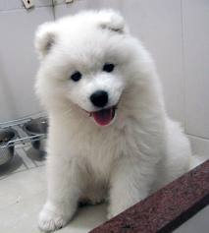
Dog – what do you “see”?

Slide 24
I can say “water”. I can say “H-two-O”. I can write “H₂O”. I could say “dihydrogen monoxide”.
If you don’t already, you’ll learn to think “water” for all of those things.
But what do you picture?

Slide 25
Water
Water Dihydrogen monoxide
H-two-Oh H₂O
All symbols.

Slide 26
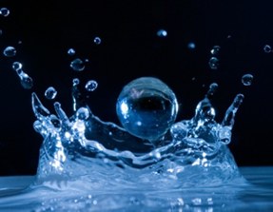

Water
Water Dihydrogen monoxide
H-two-Oh H₂O
Physical object.
You’ve drunk it, washed in it, swam in it, boiled it, froze it, mixed it with other materials…
There’s the tiny invisible molecules that make up water. It is ultimately their collective action that you observe.

Slide 27
MOLECULES MOVE!
http://www.youtube.com/watch?v=cThvGD-o_90&feature=related
http://www.youtube.com/watch?v=ll0BqGHknSg
So even beyond picturing the water molecules, we want to develop a sense of the interaction of molecules with each other and their environment. They aren’t simply a static picture.

Slide 28
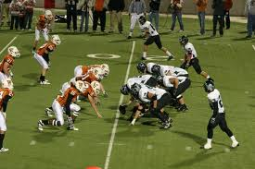
“Football team”

Slide 29
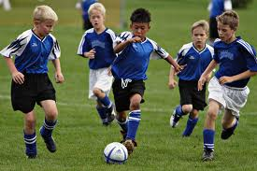
Of course most of the world thinks…
But along with that you have a lot of knowledge. You know how people move. You know what happens when two people bump into each other…

Slide 30
Chemistry is easy…
…if you develop the same sense of the molecular rules as you have for everyday events.
A lot of the rules are very similar…

Slide 31
When molecules collide…
http://www.youtube.com/watch?v=Uuz_jdMajf8

