Slide 1
Chemical Equilibrium
Some more complicated applications

Slide 2
The ICE chart is a powerful tool for many different equilibrium problems
But you can’t always make a simplifying assumption, and that means that you may need to do a little algebra

Slide 3
A Quadratic Equation
A quadratic equation is a 2nd order polynomial of the general form:
a x² + b x + c = 0
Where a, b, and c represent number coefficients and x is the variable

Slide 4
The Quadratic Formula
a x² + b x + c = 0
All quadratic equations have a solution for x that is given by:
$$x=\frac{−b±\sqrt{b^{2}−4ac}}{2a}$$

Slide 5
Equilibrium & the Quadratic Formula
If you cannot make a simplifying assumption, many times you will end up with a quadratic equation for an equilibrium constant expression.
You can end up with a 3rd, 4th, 5th, etc. order polynomial, but I will not hold you responsible for being able to solve those as there is no simple formula for the solution.

Slide 6
A sample problem.
A mixture of 0.00250 mol H_{2 (g)} and 0.00500 mol of I_{2 (g)} was placed in a 1.00 L stainless steel flask at 430 °C. The equilibrium constant, based on concentration, for the creation of HI from hydrogen and iodine is 54.3 at this temperature.
What are the equilibrium concentrations of all 3 species?

Slide 7
Determining the concentrations
ICE - ICE - BABY - ICE – ICE
The easiest way to solve this problem is by using an ICE chart.
We just need a BALANCED EQUATION

Slide 8
An ICE Chart
H₂ _{(g)} + I₂ _{(g)} ↔ 2 HI _{(g)}

Slide 9
An ICE Chart
H₂ _{(g)} + I₂ _{(g)} ↔ 2 HI _{(g)}
I
C
E
0.00250 M |  |  | 0.00500 M |  | 0 M
x |  |  | -x |  | +2x
0.00250 – x |  |  | 0.00500 – x |  | 2x

Slide 10
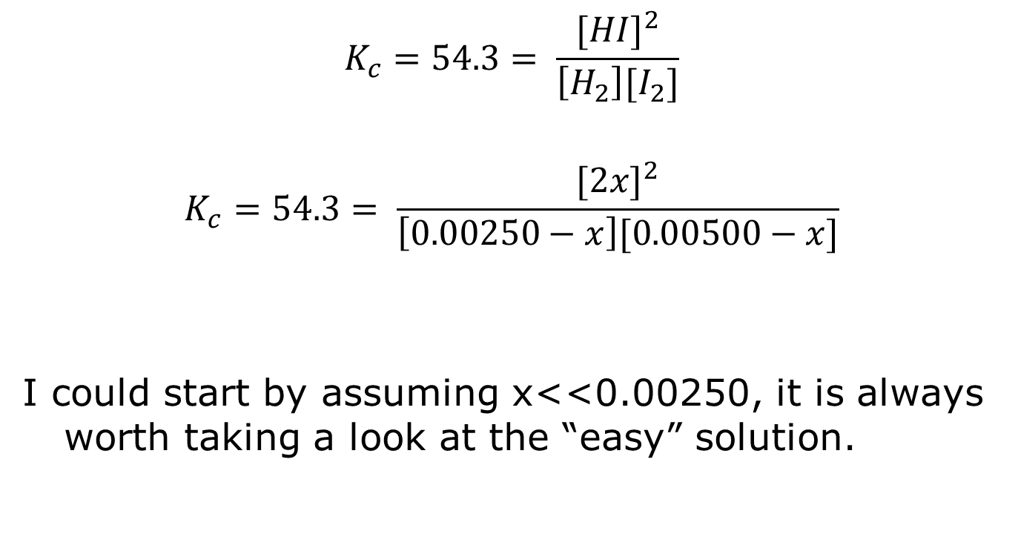
Plug these numbers into the equilibrium constant expression.
$$K_{c}=54.3= \frac{{[HI]}^{2}}{\left[H_{2}\right][I_{2}]}$$
$$K_{c}=54.3= \frac{{[2x]}^{2}}{\left[0.00250−x\right][0.00500−x]}$$
I could start by assuming x<<0.00250, it is always worth taking a look at the “easy” solution.

Slide 11
Are we good to the K-equation
Yes
No, please talk more
I really can’t get past my test grade, so I can’t be bothered with your stupid problem.

Slide 12
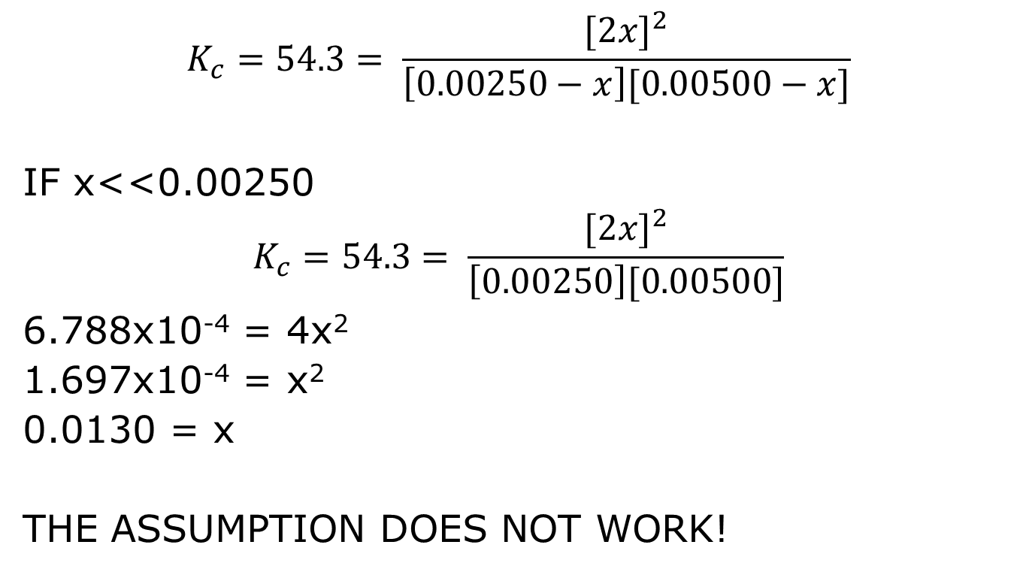
Assuming x is small…
$$K_{c}=54.3= \frac{{[2x]}^{2}}{\left[0.00250−x\right][0.00500−x]}$$
IF x<<0.00250
$$K_{c}=54.3= \frac{{[2x]}^{2}}{\left[0.00250\right][0.00500]}$$
6.788x10⁻⁴ = 4x²
1.697x10⁻⁴ = x²
0.0130 = x
THE ASSUMPTION DOES NOT WORK!

Slide 13

$$\frac{0.00250}{20}=0.000125$$
X=0.0130 (from the solution)

Slide 14
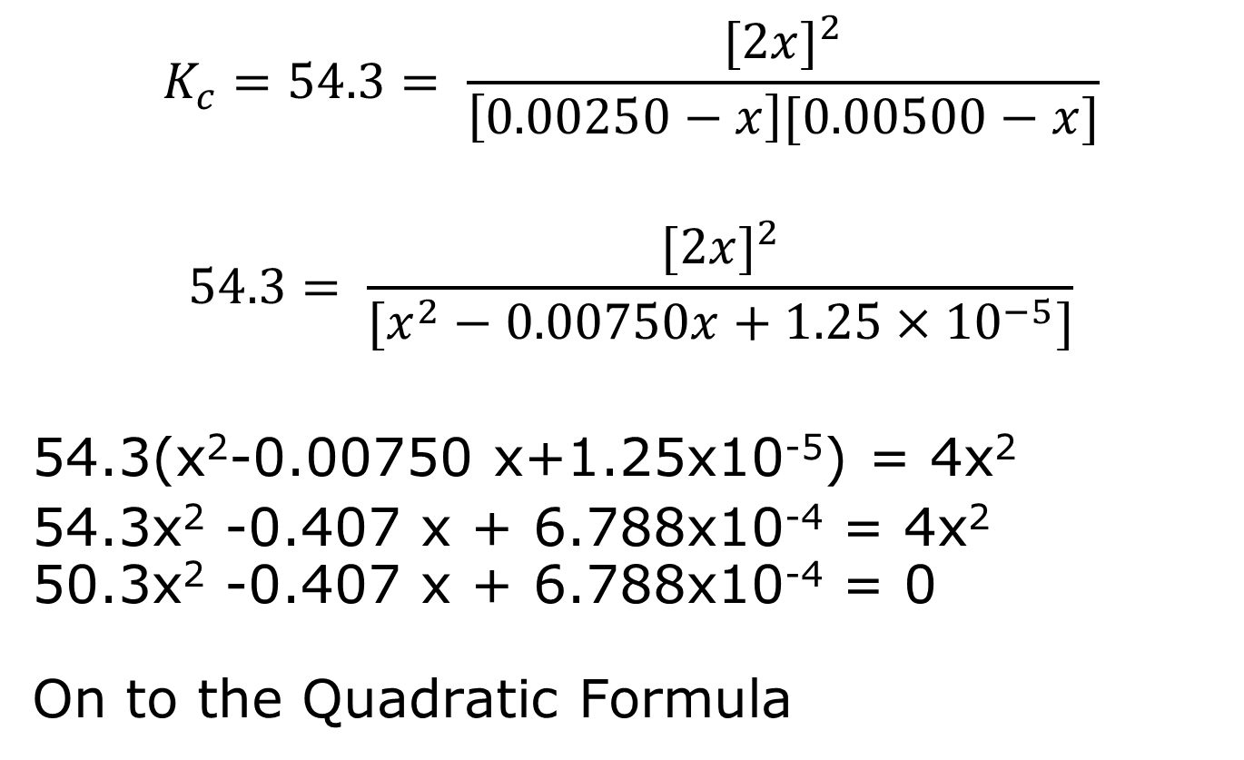
We’re going to have to use the quadratic formula
$$K_{c}=54.3= \frac{{[2x]}^{2}}{\left[0.00250−x\right][0.00500−x]}$$
$$54.3= \frac{{[2x]}^{2}}{[x^{2}−0.00750x+1.25×{10}^{−5}]}$$
54.3(x²-0.00750 x+1.25x10⁻⁵) = 4x²
54.3x² -0.407 x + 6.788x10⁻⁴ = 4x²
50.3x² -0.407 x + 6.788x10⁻⁴ = 0
On to the Quadratic Formula

Slide 15
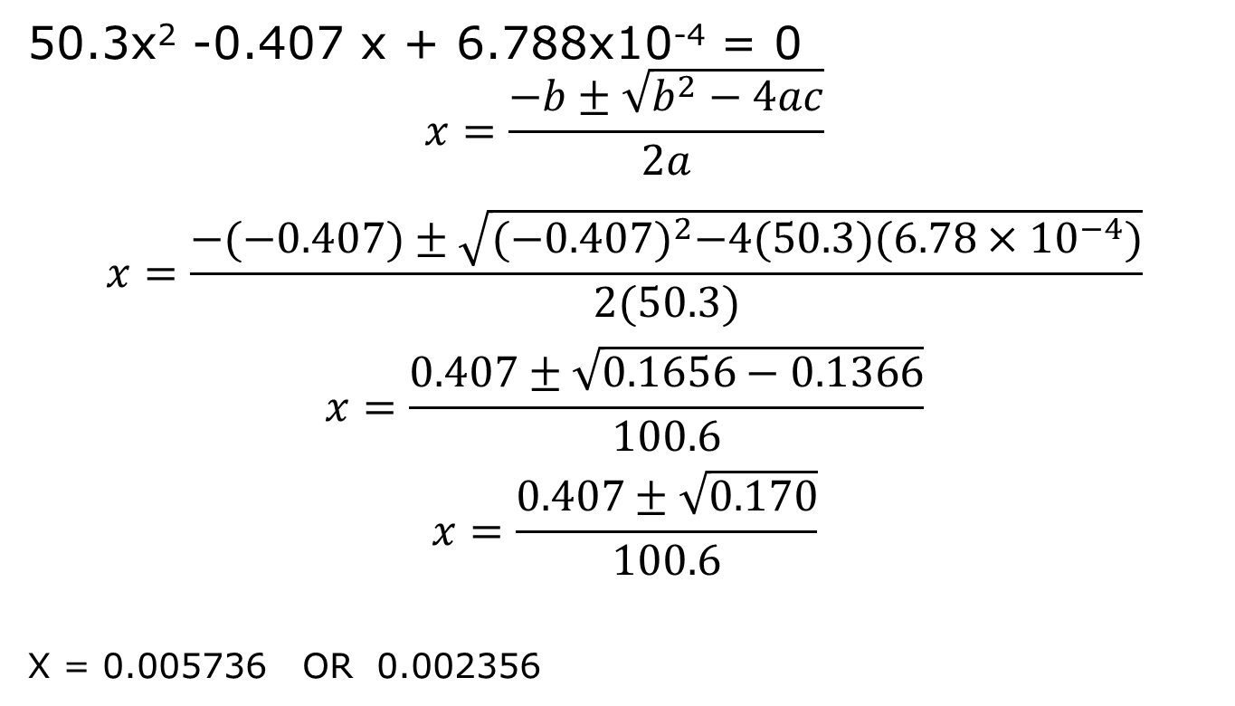
Using the quadratic formula
50.3x² -0.407 x + 6.788x10⁻⁴ = 0
$$x=\frac{−b±\sqrt{b^{2}−4ac}}{2a}$$
$$x=\frac{−(−0.407)±\sqrt{{(−0.407)}^{2}−4(50.3)(6.78×{10}^{−4})}}{2(50.3)}$$
$$x=\frac{0.407±\sqrt{0.1656−0.1366}}{100.6}$$
$$x=\frac{0.407±\sqrt{0.170}}{100.6}$$
X = 0.005736 OR 0.002356

Slide 16
There are 2 roots…
All 2nd order polynomials have 2 roots, BUT only one will make sense in the equilibrium problem
x = 0.005736 OR 0.002356
Which is correct?
Look at the ICE chart and it will be clear.

Slide 17
x = 0.005736 OR 0.002356
H₂ _{(g)} + I₂ _{(g)} ↔ 2 HI _{(g)}
I
C
E
If x = 0.005736, then the equilibrium concentrations of the reactants would be NEGATIVE! This is a physical impossibility.
0.00250 M |  |  | 0.00500 M |  | 0 M
x |  |  | -x |  | +2x
0.00250 – x |  |  | 0.00500 – x |  | 2x

Slide 18
SO x = 0.002356
H₂ _{(g)} + I₂ _{(g)} ↔ 2 HI _{(g)}
I
C
E
And you are done!
0.00250 M |  |  | 0.00500 M |  | 0 M
0.002356 |  |  | -0.002356 |  | +2(0.002356)
0.000144 M |  |  | 0.002644 M |  | 0.00471 M

Slide 19
`
X IS NOT THE ANSWER
X IS A WAY TO GET TO THE ANSWER

Slide 20
Another Itty Bitty Problem
CaCO_{3 (s)} will decompose to give CaO _{(s)} and CO_{2 (g)} at 350°C. A sample of calcium carbonate is sealed in an evacuated 1 L flask and heated to 350 °C. When equilibrium is established, the total pressure in the flask is 0.105 atm. What is K_{c} and K_{p}?

Slide 21
Another Itty Bitty Problem
CaCO_{3 (s)} will decompose to give CaO _{(s)} and CO_{2 (g)} at 350°C. A sample of calcium carbonate is sealed in an evacuated 1 L flask and heated to 350 °C. When equilibrium is established, the total pressure in the flask is 0.105 atm. What is K_{c} and K_{p}?

Slide 22
As always, we 1st need a balanced equation:

Slide 23
As always, we 1st need a balanced equation:
CaCO_{3 (s)} ↔ CaO _{(s)} + CO_{2 (g)}
Then we can immediately write the equilibrium constant expressions:

Slide 24
As always, we 1st need a balanced equation:
CaCO_{3 (s)} ↔ CaO _{(s)} + CO_{2 (g)}
Then we can immediately write the equilibrium constant expressions:
K_{c} = [CO₂]
K_{p} = P_{CO2}

Slide 25
Another Itty Bitty Problem
CaCO_{3 (s)} will decompose to give CaO _{(s)} and CO_{2 (g)} at 350°C. A sample of calcium carbonate is sealed in an evacuated 1 L flask and heated to 350 °C. When equilibrium is established, the total pressure in the flask is 0.105 atm. What is K_{c} and K_{p}?

Slide 26
K_{c} = [CO₂]
[CO₂] = moles CO₂/L
How do we determine the # of moles?

Slide 27
All of the pressure must be due to the carbon dioxide.
As a gas, carbon dioxide should obey the ideal gas law.
P V = n R T
And we know P, V, R, and T!!

Slide 28
P V = n R T
And we know P, V, R, and T!!
In fact, we could calculate moles/L directly:
PV = n R T
$$\frac{P}{RT}=\frac{n}{V}=M$$
Either way will work.

Slide 29
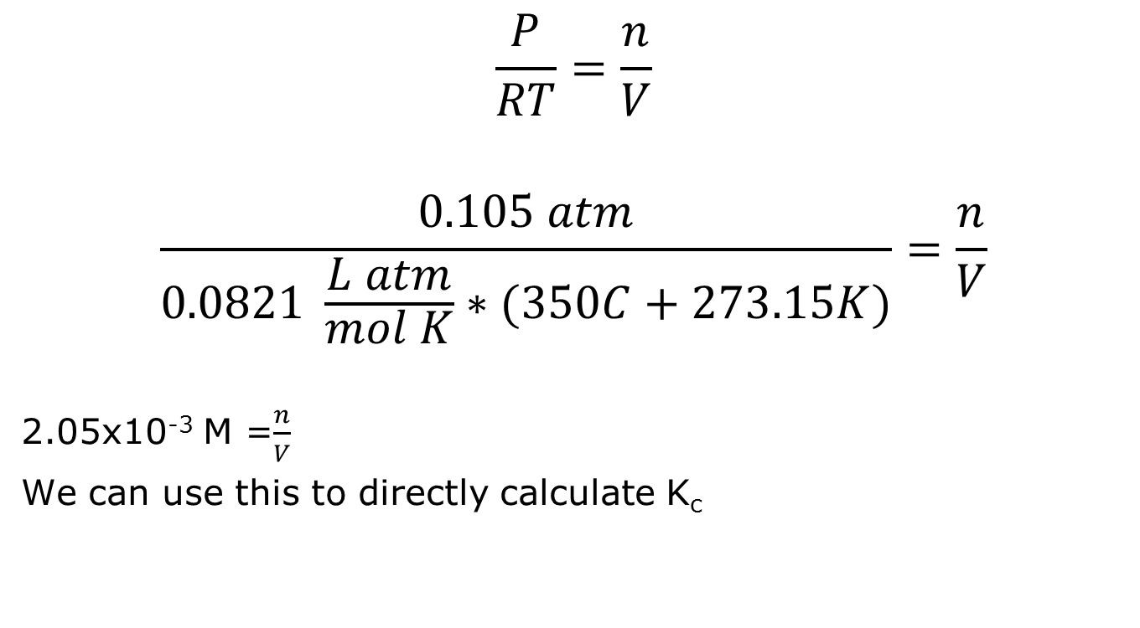
$$\frac{P}{RT}=\frac{n}{V}$$
$$\frac{0.105 atm}{0.0821 \frac{L atm}{mol K}∗(350C+273.15K)}=\frac{n}{V}$$
2.05x10⁻³ M =$\frac{n}{V}$
We can use this to directly calculate K_{c}

Slide 30
K_{c} = [CO₂]
K_{c} = 2.05x10⁻³
And we’re done!!! (Boring when there’s no exponents, isn’t it? ☺)
What about K_{p}?

Slide 31
K_{p} = P_{CO2}
K_{p} = 0.105
And we’re essentially done!
Now, that may have seemed simple, but it does point out something interesting about the relationship between K_{c} and K_{p}

Slide 32
K_{p} is NOT A PRESSURE

Slide 33
K_{c} vs K_{p}
K_{c} depends on concentration (moles/L)
K_{p} depends on pressure (atm)
For gases, pressure and concentration are directly related.

Slide 34
K_{c} vs K_{p}
P V = nRT
$\frac{P}{RT}=\frac{n}{V}$=M
The only difference between P and M is (RT)

Slide 35

K_{c} vs K_{p}
K_{c} = [CO₂] = $\frac{n}{V}=\frac{P_{{CO}_{2}}}{RT}=\frac{K_{P}}{RT}$
Or, alternatively
K_{p} = K_{c} (RT)
This can be generalized.

Slide 36
K_{c} vs K_{p} - in general
Consider a general reaction:
x A _{(g)} + y B _{(g)} ↔ z C _{(g)}
And I can quickly write K_{c} and K_{p}:
$$K_{c}=\frac{{\left[C\right]}^{Z}}{{\left[B\right]}^{y}{\left[A\right]}^{x}}$$
$$K_{p}=\frac{P_{C}^{z}}{\begin{aligned}P_{B}^{y} P_{A}^{x} \\ \end{aligned}}$$

Slide 37
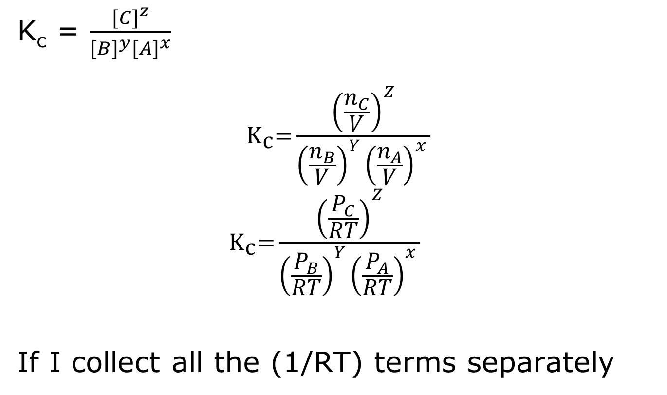
Using the Ideal Gas Law…
K_{c} = $\frac{{[C]}^{z}}{{[B]}^{y}{[A]}^{x}}$
$${\text{K}}_{\text{c}}\text{=}\frac{{\left(\frac{n_{C}}{V}\right)}^{Z}}{{\left(\frac{n_{B}}{V}\right)}^{Y}{\left(\frac{n_{A}}{V}\right)}^{x} }$$
$${\text{K}}_{\text{c}}\text{=}\frac{{\left(\frac{P_{C}}{RT}\right)}^{Z}}{{\left(\frac{P_{B}}{RT}\right)}^{Y}{\left(\frac{P_{A}}{RT}\right)}^{x} }$$
If I collect all the (1/RT) terms separately

Slide 38
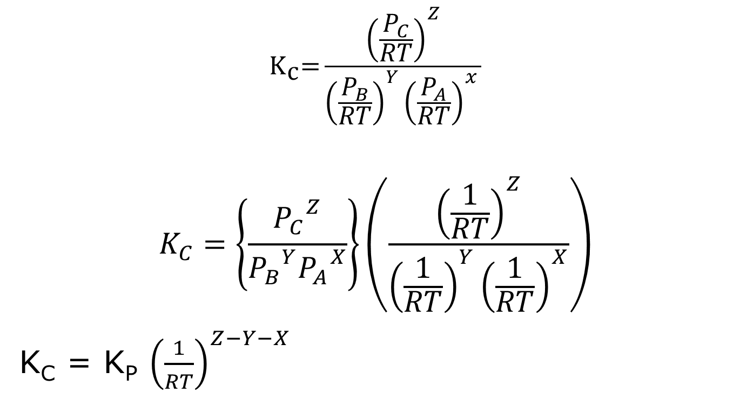
If I collect all the (1/RT) terms separately
$${\text{K}}_{\text{c}}\text{=}\frac{{\left(\frac{P_{C}}{RT}\right)}^{Z}}{{\left(\frac{P_{B}}{RT}\right)}^{Y}{\left(\frac{P_{A}}{RT}\right)}^{x} }$$
$$K_{C}=\left\{\frac{{P_{C}}_{}^{Z}}{{P_{B}}_{}^{Y}{P_{A}}^{X}}\right\}\left(\frac{{\left(\frac{1}{RT}\right)}^{Z}}{{\left(\frac{1}{RT}\right)}^{Y}{\left(\frac{1}{RT}\right)}^{X}}\right)$$
K_{C} = K_{P} ${\left(\frac{1}{RT}\right)}^{Z−Y−X}$

Slide 39
Simplifying…
K_{C} = K_{P} ${\left(\frac{1}{RT}\right)}^{Z−Y−X}$
Z-Y-X is just the change in the stoichiometry of the reaction:
Z moles of products – Total moles of reactants (Y+X)

Slide 40
Simplifying…
K_{C} = K_{p} ${\left(\frac{1}{RT}\right)}^{∆n}$
Δn = total moles of product gas – total moles of reactant gas
This is the general relationship between K_{p} and K_{c} for all gas phase reactions.

Slide 41
Another K_{p} vs K_{c} problem
2 SO_{3 (g)} ↔ 2 SO_{2 (g)} + O_{2 (g)}
The above reaction has a K_{p} value of 1.8x10⁻⁵ at 360°C. What is K_{c} for the reaction?

Slide 42
If we recall that:
K_{C} = K_{p} ${\left(\frac{1}{RT}\right)}^{∆n}$
The solution is simple.
Δn = 3 moles product gas – 2 moles reactant gas
So:
K_{C} = 1.8x10⁻⁵ ${\left(\frac{1}{(0.0821\frac{L atm}{mol K})(360C+273.15 K)}\right)}^{1}$
K_{c} = 3.46x10⁻⁷

