Slide 1
Thermodynamic Connection
Q and G and letters other than K

Slide 2
Reaction Quotient
What do you call an equilibrium constant when you aren’t at equilibrium?
A Reaction Quotient! (Q)

Slide 3
Consider…
1 mole of Hydrogen, 2 moles of Oxygen, and 1 mole of water are mixed in a 2 L flask at 800 K. The equilibrium constant for the formation of steam at 800 K is 1.6 x 10⁻⁶. Find the equilibrium concentrations…yada yada yada

Slide 4
Let’s just set it up
2 H₂ _{(g)} + O₂ _{(g)} ↔ 2 H₂O _{(g)}
Initial
Change
Equilibrium
M is preferable if I’m going to solve the K expression for [equilibrium]
1 mol/2L 0.5 M | 2 mol/2L 1 M | 1 mol/2L 0.5 M

Slide 5
Let’s just set it up
2 H₂ _{(g)} + O₂ _{(g)} ↔ 2 H₂O _{(g)}
Initial
Change
Equilibrium
We don’t need to know the sign, it’ll all come out in the solution, but is there a way to know???
0.5 M | 1 M | 0.5 M
2 x ??? +2x | X ??? + x | + 2 x ??? -2x

Slide 6
Q tells us where we are
Q = [products NOT at equilibrium]
[reactants NOT at equilibrium]
In this case:
Q = [H₂O]² = (0.5 M)² = 1
[H₂]²[O₂] (0.5 M)²(1 M)

Slide 7
What does the “Q=1” mean?
How should we evaluate Q?
Q is just K when I haven’t gotten to K, so Q is trying to become K.
Compare Q to K
K = 1.6x10⁻⁶ at this temperature

Slide 8
Q=1, K=1.6x10⁻⁶
A The reaction needs to go right to get to equilibrium
B. The reaction needs to go left
C. The reaction is at equilibrium
D. I don’t care because I don’t want to justify my answer
E. I’m sleeping.

Slide 9
Q = 1
K = 1.6 x 10⁻⁶
Q is too BIG…
Q = [products] [products] is too big!
[reactants]
Reaction must go left to get rid of the products to reach equilibrium.

Slide 10
Q vs. K
If Q>K, too many products, reaction goes left.
If Q<K, too many reactants (too few products), reaction goes right.
If Q = K…everything is just right!

Slide 11
Too many products, so…
2 H₂ _{(g)} + O₂ _{(g)} ↔ 2 H₂O _{(g)}
Initial
Change
Equilibrium
So, we can determine the sign of the change if we want to!
0.5 M | 1 M | 0.5 M
+2x | + x | -2x

Slide 12
K in context
We’ve talked about a number of different realms of Chemistry.
Kinetics – How fast?
Thermodynamics – How stable? How hot?
Equilibrium…???

Slide 13
Equilibrium and Thermodynamics
Would it surprise you to know that Equilibrium represents the thermodynamic balance between the products and the reactants?
Equilibrium tells us what the balance should be, but says nothing about how fast (kinetics) it takes to get there.

Slide 14
Gibbs Free Energy
Gibbs Free Energy is the most important thermodynamic variable: it balances enthalpy and entropy.
ΔG = Δ H - T Δ S
If Δ G < 0, what does that mean?
Reaction is spontaneous as written.
If Δ G > 0, what does that mean?
Reaction is spontaneous in the reverse direction.

Slide 15
Δ G sounds a lot like Q!

Slide 16
K (Q) is related to Δ G
If Δ G < 0, reaction is spontaneous as written (to right).
If Δ G > 0, reaction is spontaneous in the reverse direction (to left).
If Q>K, reaction goes left.
If Q<K, reaction goes right.
If Q = K, we’re at equilibrium. At equilibrium, Δ G = 0!!!

Slide 17
As a reaction proceeds, what happens…
You make products from reactants (or make reactants from products) until equilibrium is reached.
Assume Q<K, what does that mean?
Reaction wants to go right. So Δ G…?
Δ G < 0
Eventually, you reach equilibrium, Q = K. Δ G=0
Δ G must depend on concentration!!!

Slide 18
Δ G is “naught”y
What’s the difference between Δ G and Δ G⁰?
Δ G⁰ is at standard conditions:
1. 298 K
2. 1 atm
3. Stoichiometric quantities of everything (1 M aqueous, 1 atm gases)
Δ G is at any arbitrary conditions

Slide 19
How does Δ G depend on concentration?
Δ G = Δ G⁰ + RT ln Q
RT ln Q is the correction factor for concentration…
This also gives us a way to calculate K!
When we reach equilibrium Q = K!
When we reach equilibrium Δ G = 0!

Slide 20
How does ΔG depend on temperature?
Δ G= Δ G⁰ + RT ln Q
0 = Δ G⁰ + RT ln K
Δ G⁰ = - RT ln K
Δ G⁰ ⁼ Δ H⁰ - T Δ S⁰ = - RT ln K
AND Δ G⁰ IS IN APPENDIX II!!!

Slide 21
Sample Problem
What is the equilibrium constant for the following reaction at 250 ºC?
CO _{(g)} + 2 H_{2 (g)} ↔ CH₃OH _{(g)}
Δ H⁰ - T Δ S⁰ = - RT ln K
Δ H⁰ = H_{f}⁰ (products) – H_{f}⁰ (reactants)
Δ S⁰ = S_{f}⁰ (products) – S_{f}⁰ (reactants)

Slide 22
Sample Problem
What is the equilibrium problem for the following reaction at 250 ºC?
CO _{(g)} + 2 H_{2 (g)} ↔ CH₃OH _{(g)}
Δ H⁰ = ∆H_{f}⁰ (products) – ∆H_{f}⁰ (reactants)
= (-201.0 kJ) – (-110.5 kJ + 2(0))
= -90.5 kJ
Δ S⁰ = S_{f}⁰ (products) – S_{f}⁰ (reactants)
= (239.9 J/K) – (197.7 J/K + 2(130.7 J/K))
= - 219.2 J/K

Slide 23
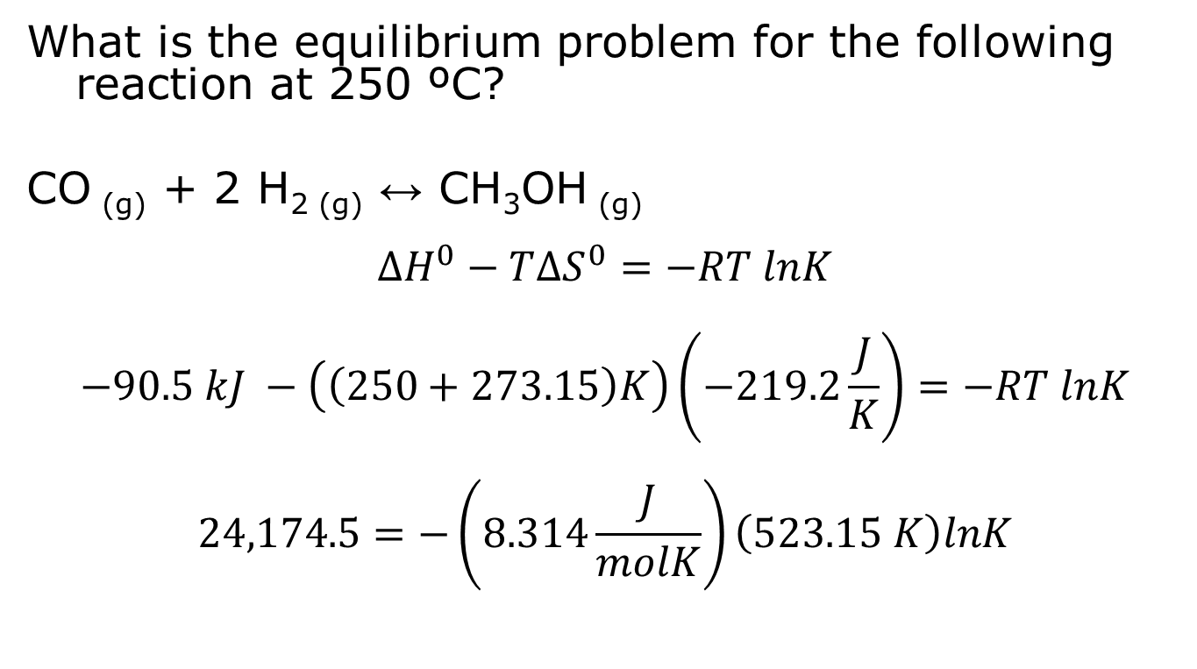
Sample Problem
What is the equilibrium problem for the following reaction at 250 ºC?
CO _{(g)} + 2 H_{2 (g)} ↔ CH₃OH _{(g)}
$$∆H^{0}−T∆S^{0}=−RT lnK$$
$$−90.5 kJ −\left(\left(250+273.15\right)K\right)\left(−219.2\frac{J}{K}\right)=−RT lnK$$
$$24,174.5=−\left(8.314\frac{J}{molK}\right)\left(523.15 K\right)lnK$$

Slide 24
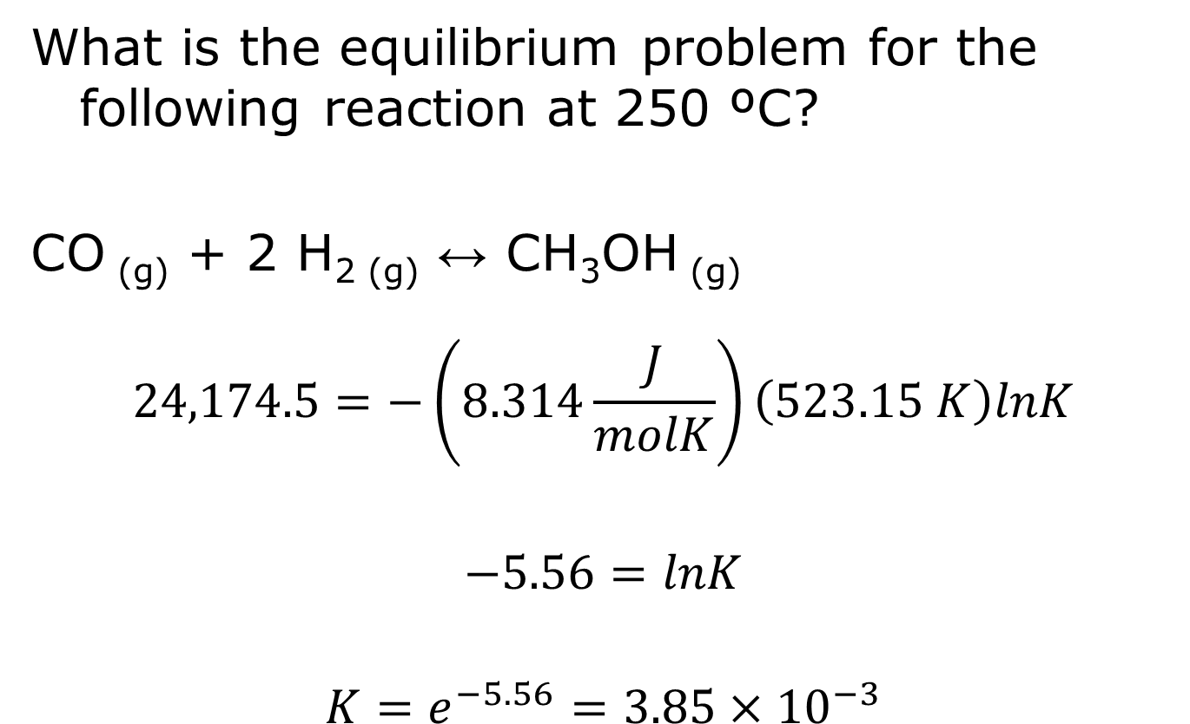
Sample Problem
What is the equilibrium problem for the following reaction at 250 ºC?
CO _{(g)} + 2 H_{2 (g)} ↔ CH₃OH _{(g)}
$$24,174.5=−\left(8.314\frac{J}{molK}\right)\left(523.15 K\right)lnK$$
$$−5.56=lnK$$
$$K=e^{−5.56}=3.85×{10}^{−3}$$

Slide 25
Clicker Question
What is the K for our favorite reaction at 25º C:
2 H_{2 (g)} + O_{2 (g)} ↔ 2 H₂O _{(g)}

Slide 26
Substance | ΔH⁰_{f} (kJ/mol) | ΔG⁰_{f} (kJ/mol) | S⁰ (J/mol*K)
H(g) | 218.0 | 203.3 | 114.7
H⁺(aq) | 0 | 0 | 0
H⁺(g) | 1536.3 | 1517.1 | 108.9
H₂(g) | 0 | 0 | 130.7
I(g) | 106.76 | 70.2 | 180.79
HI(g) | 26.5 | 1.7 | 206.6
OH⁻ (aq) | -230.02 | -157.3 | -10.90
O(g) | 249.2 | 231.7 | 161.1
O₂(g) | 0 | 0 | 205.2
O₃ (g) | 142.7 | 163.2 | 238.9
H₂O (l) | -285.8 | -237.1 | 70
H₂O (g) | -241.8 | -228.6 | 188.8
H₂O₂ (l) | -187.8 | -120.4 | 109.6
H₂O₂ (g) | -136.3 | -105.6 | 232.7
N(g) | 472.7 | 455.5 | 153.3
N₂(g) | 0 | 0 | 191.6
NH₃(g) | -46 | -16 | 193
NH₃(aq) | -80.29 | -26.50 | 111.3
NH₄⁺(aq) | -133.26 | -79.31 | 111.17
NO(g) | 91.3 | 87.6 | 210.8
NO₂(g) | 33.2 | 51.3 | 240.1
N₂O(g) | 81.6 | 103.7 | 220.0
N₂H₂(g) | 95.4 | 159.4 | 238.5
N₂O₄(g) | 9.16 | 99.8 | 304.4

Slide 27
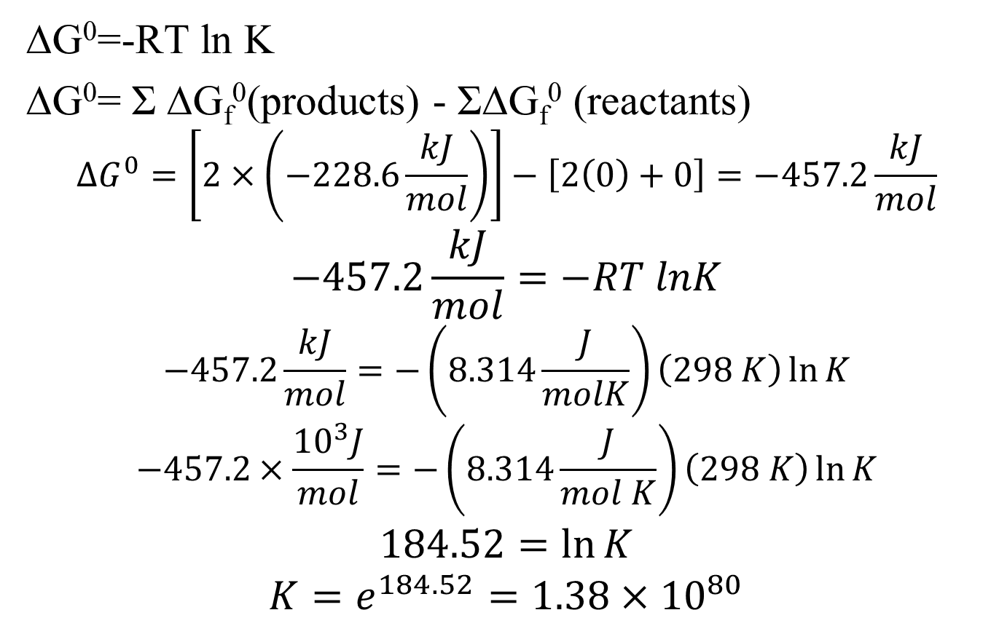
2 H_{2 (g)} + O_{2 (g)} ↔ 2 H₂O _{(g)}
∆G⁰=-RT ln K
∆G⁰= Σ ∆G_{f}⁰(products) - Σ∆G_{f}⁰ (reactants)
$$∆G^{0}=\left[2×\left(−228.6\frac{kJ}{mol}\right)\right]−\left[2\left(0\right)+0\right]=−457.2\frac{kJ}{mol}$$
$$−457.2\frac{kJ}{mol}=−RT lnK$$
$$−457.2\frac{kJ}{mol}=−\left(8.314\frac{J}{molK}\right)\left(298 K\right)\ln{K}$$
$$−457.2×\frac{{10}^{3}J}{mol}=−\left(8.314\frac{J}{mol K}\right)\left(298 K\right)\ln{K}$$
$$184.52=\ln{K}$$
$$K=e^{184.52}=1.38×{10}^{80}$$

Slide 28
Clicker Question
What is the K for our favorite reaction at 1000 K:
2 H_{2 (g)} + O_{2 (g)} ↔ 2 H₂O _{(g)}

Slide 29
-457.2 kJ/mol = -RT ln K
-457.2 kJ/mol = -(8.3145 J/mol K)(1000 K) ln K
-457.2 x10³ J/mol = -(8.3145 J/mol K)(1000 K) ln K
54.988=lnK
K=e^{54.988}= 7.6x10²³

Slide 30
Le Chatelier’s Principle
It’s FRENCH! (Very classy!)
Uncle Joe’s stress management hints!

Slide 31
1 atm O₂, 0.5 atm H₂ and 0.1 atm of H₂O are mixed.

Slide 32
If I shove you, what do you do?
Shove back
Step back and absorb the blow
Get a gun and escalate the fight
Cry

Slide 33
If I shove you, what do you do?
Shove back (Yeah, right!)
Step back and absorb the blow (NICE!)
Get a gun and escalate the fight (Seriously, ruin your life over a shove.)
Cry (Probably…but not constructive.)

Slide 34
In fact, the best move…
…roll with the shove.
THAT is Le Chatelier’s principle: A system under stress responds to alleviate the stress.
Equilibrium reactions are constantly going in both directions. If you stress the reaction in any way, the reactions respond to the stress.

Slide 35
If I turn down the thermostat in here to 40 degrees, what do you do?
You are cold you need to get heat.
How would a reaction get heat?
One reaction is EXOthermic, one is ENDOthermic. If you turn down the thermostat, the reaction just turns up its thermostat!

Slide 36
If you turn down T…
…you favor the exothermic reaction.
The equilibrium shifts to relieve the stress.

Slide 37
If you turn up the heat…
…you favor the endothermic reaction (absorbing heat).
The equilibrium shifts to accommodate the stress.

Slide 38
2 H₂ + O₂ ↔ 2 H₂O
If I add hydrogen, what does the reaction do?
Make more water to use up the hydrogen!

Slide 39
2 H₂ + O₂ ↔ 2 H₂O
2 H₂ + O₂ ↔ 2 H₂O
You’ve upset the equilibrium!
E | 2 mol | 2 mol |  | 5 mol
stress | +1 mol
I | 3 mol | 2 mol |  | 5 mol

Slide 40
2 H₂ + O₂ ↔ 2 H₂O
If I you remove water from the system, what does the reaction do?
Make more water!

Slide 41
2 H₂ + O₂ ↔ 2 H₂O
2 H₂ + O₂ ↔ 2 H₂O
You’ve upset the equilibrium!
Δ G= Δ G⁰ + RT ln Q
You were at ∆G=0, Q=K
E | 2 mol | 2 mol |  | 5 mol
stress |  |  |  | -3 mol
I | 2 mol | 2 mol |  | 2 mol

Slide 42
2 H₂ (g) + O₂ (g) ↔ 2 H₂O (g)
Suppose you increase the Pressure!!!
The reaction makes itself “small”…shifts to the right. 2 moles of water takes up less space than 3 moles of reactants IF they are all gases.

Slide 43
H₂O (s) ↔ H₂O (l)
Left
Right
No effect

Slide 44
The test ends here…
Topics for the test:
Titration curves
Strong acid/strong base
Weak acid/strong base or strong acid/weak base
Buffers
Salts
Ka or Kb or Kw
Soup Problems – mixtures of stuff
Ksp
Solubility
Fractional precipitation
Thermodynamics
∆H, ∆S, ∆G
Delta G = Delta H – T delta S
K (∆G=∆Gº+RT ln Q)

Slide 45
Don’t forget
Exam review homework is due at 8 p.m. on Thursday.
Complete solutions for exam review homework appear magically on myCourses under “Content” at 9:01 p.m. on Wednesday.

