Slide 1
Hardness
What’s in your pipes?

Slide 2

What’s the “concentration” of red triangles?
500 mL
10$\frac{red triangles}{L}$
10 $\frac{g}{L}$
$1\% by mass$
$0.01\frac{g}{mL}$
It’s all of the above!
1 g
1 g
1 g
1 g
1 g

Slide 3
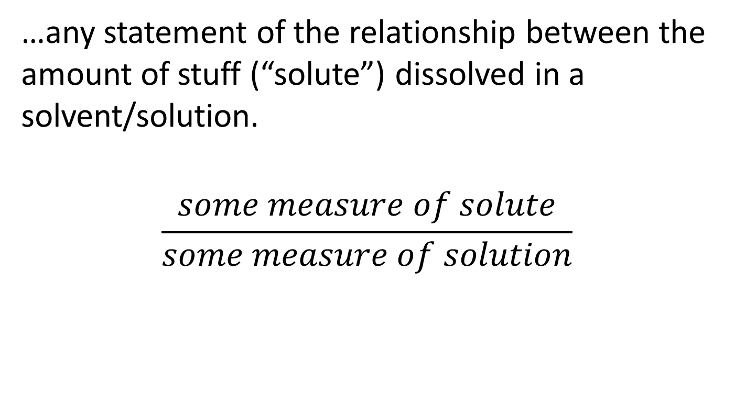
Concentration is…
…any statement of the relationship between the amount of stuff (“solute”) dissolved in a solvent/solution.
$$\frac{some measure of solute}{some measure of solution}$$

Slide 4
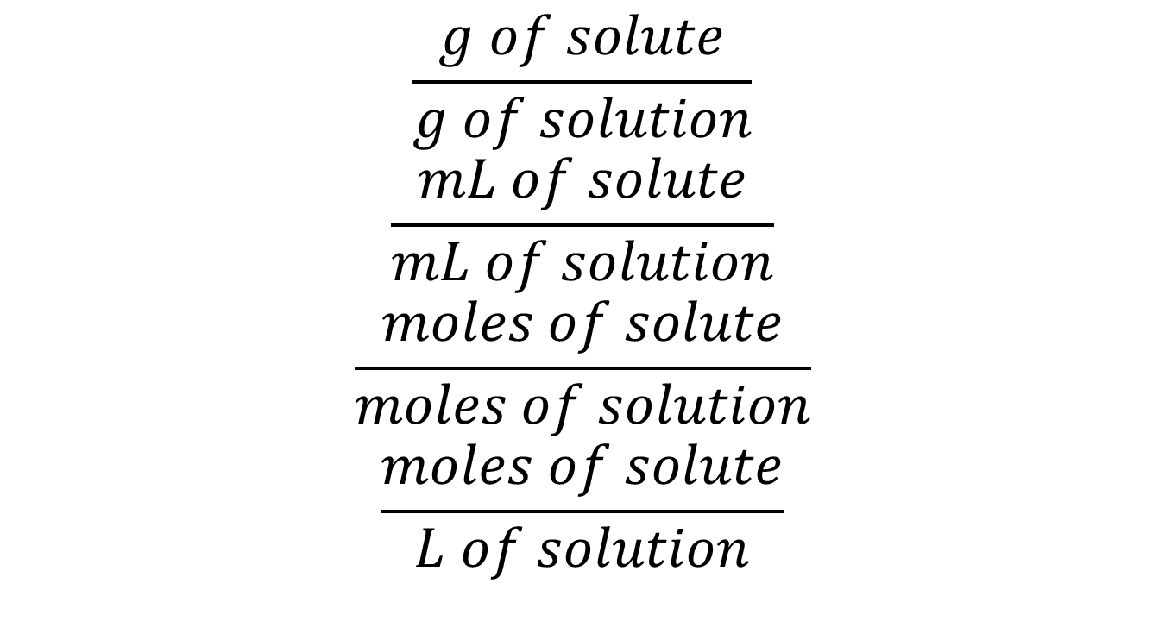
Could be ANYTHING
$$\frac{g of solute}{g of solution}$$
$$\frac{mL of solute}{mL of solution}$$
$$\frac{moles of solute}{moles of solution}$$
$$\frac{moles of solute}{L of solution}$$

Slide 5
UNITS! UNITS! UNITS!
The units are your friend – ALWAYS! The units tell you how to measure your “stuff”.
$$M=\frac{moles of solute}{L of solution}$$
So, if I’ve got Molarity (M), I probably want to measure the volume…

Slide 6

$$L of solution\frac{moles of solute}{L of solution}=moles of solute$$

Slide 7
If I have…
$$\frac{g of solute}{g of solution}$$
Then I want to measure…
GRAMS of solution!

Slide 8
$$grams of solution\frac{grams of solute}{grams of solution}=grams of solute$$
Concentration is always just a conversion factor between the way you measured the solution and how much solute you’ve got!
The SOLUTE is almost always the thing you care about. The solvent/solution is just the carrier.

Slide 9
It’s a question of what they DO!
All I really see is what they do. I never actually see “them”.
This is really the take home lesson for waste water analysis: how specific is your test?
Mg²⁺
Mg²⁺
Mg²⁺
Mg²⁺

Slide 10
Alkalinity
We saw this with alkalinity. We don’t really know what the base is, we only know how much acid it eats.
For alkalinity, this is the only thing that matters. And from a site standpoint, that’s all you’ll care about.

Slide 11
Sometimes, what you don’t know will kill you.
The difference between OH⁻ and HCO₃⁻ is unimportant.
What about the difference between iron (Fe) and lead (Pb)?
Pb could shut your site down if you find it.
Pb could get your butt sued down the line if you don’t find it.

Slide 12
Spend the bucks on what counts
Some tests are more specific than others.
Spend your testing budget on the things that matter.
Total alkalinity is usually enough.
Total metals is usually NOT enough.

Slide 13
Hardness
We experience “hardness” of water directly in several ways:
A “slimy” feel to our water when bathing.
Reduced lather or foaming in soaps.
Formation of scale in pipes and near drains.

Slide 14
Chemical Identity of Hardness
Hardness is caused by dissolved metal ions.
These ions can form precipitates (with things like soap) which result in water-insoluble scale.

Slide 15
Every Cation has its Anion
Metal Cations Most common anion
Ca²⁺ HCO₃⁻
Mg²⁺ SO₄²⁻
Sr²⁺ Cl⁻
Fe²⁺ NO₃⁻
Mn²⁺ SiO₃²⁻
Do you recognize these species?

Slide 16
Every Cation has its Anion
Metal cations Most common anion
Ca²⁺ (calcium) HCO₃⁻ (bicarbonate)
Mg²⁺ (magnesium) SO₄²⁻ (sulfate)
Sr²⁺ (strontium) Cl⁻ (chloride)
Fe²⁺ (iron) NO₃⁻ (nitrate)
Mn²⁺ (manganese) SiO₃²⁻ (silicate)
What happens when they meet?

Slide 17
Every Cation has its Anion
Metal cations Most common anion
Ca²⁺ (calcium) HCO₃⁻ (bicarbonate)
calcium bicarbonate - Ca(HCO₃)₂
Mg²⁺ (magnesium) SO₄²⁻ (sulfate) magnesium sulfate – MgSO₄
Sr²⁺ (strontium) Cl⁻ (chloride) strontium chloride – SrCl₂
Fe²⁺ (iron) NO₃⁻ (nitrate)
iron nitrate – Fe(NO₃)₂
Mn²⁺ (manganese) SiO₃²⁻ (silicate)
manganese silicate – MnSiO₃

Slide 18
And the problem is…
…all of the compounds are water-insoluble solids.

Slide 19
How do you make a precipitate?
How do I make a water-insoluble precipitate with water?
I need two sources of ions – could even be two water sources.
I need to decrease the water and increase the concentration of the ions until I am below the solubility.

Slide 20
Quick Review
What is “solubility”?
It is the MAXIMUM amount of a substance that will dissolve in a liquid.
If I decrease the volume of water to increase the concentration, eventually I have a supersaturated solution and the solid precipitates.

Slide 21
Determining Hardness
If you are looking for “hardness”, what are you actually searching for…?
Metal ions!
What’s the easiest way to quantify the amount of metal ions?
TITRATE THEM!

Slide 22
Titrations – you can’t escape ‘em
EDTA (ethylenediaminetetraacetic acid) is a chemical compound that binds to most metal ions, especially divalent species (charges of 2+).
In any titration, what do you need?

Slide 23
Titrations
Balanced chemical equation
Indicator of equivalence

Slide 24
Balanced equation
M²⁺ + EDTA⁴⁻ → [M-EDTA]²⁻ + 2H⁺
(the H⁺ comes from the EDTA)
The important point is that the reaction is 1:1

Slide 25
It’s a question of what they DO!
Any of the divalent metals (not to mention a few others) will bind to EDTA
That makes the EDTA NON-SPECIFIC!
Mg²⁺
Ca²⁺
EDTA
EDTA
Mg²⁺
Pb²⁺
EDTA
EDTA

Slide 26
Indicator
EDTA, M²⁺, and M-EDTA are all soluble and colorless. So, you won’t see any change…
We need a secondary indicator – a second chemical reaction that will result in some visible change.

Slide 27
A couple of possible indicators
Calmagite or Eriochrome Black T are blue dyes when alone in water. When it is complexed with a Metal ion, it turns red.
How does this help you? What would you see?

Slide 28
Initially (before EDTA is added):
M²⁺ + dye → M²⁺-dye
blue red
When you begin to add EDTA:
M²⁺ + EDTA → M-EDTA
M²⁺ + dye → M²⁺-dye
blue red
At equivalence ([EDTA]=[M]):
M²⁺ + EDTA → M-EDTA
Dye (blue)
Mg²⁺
Ca²⁺
EDTA
Mg²⁺
Pb²⁺
EDTA
EDTA

Slide 29
Initially, there is NO EDTA
Initially (before EDTA is added):
M²⁺ + dye → M²⁺-dye
blue red
The indicator is the ONLY thing that binds to the metal.
Then you start titrating..
Mg²⁺
Ca²⁺
Mg²⁺
Pb²⁺

Slide 30
Now there IS EDTA
Initially (before EDTA is added):
M²⁺ + dye → M²⁺-dye
blue red
When you begin to add EDTA:
M²⁺ + EDTA → M-EDTA
M²⁺ + dye → M²⁺-dye
blue red
The EDTA can bind to the metal also.
Eventually, every metal has either an EDTA or an indicator…then…
Mg²⁺
Ca²⁺
EDTA
EDTA
Mg²⁺
Pb²⁺

Slide 31
Something has to win the competition
Initially (before EDTA is added):
M²⁺ + dye → M²⁺-dye
blue red
When you begin to add EDTA:
M²⁺ + EDTA → M-EDTA
M²⁺ + dye → M²⁺-dye
blue red
If the indicator is a better binder than the EDTA, I’m done for…I’ve got a mix of binders but I have no way to know when I reach the endpoint.
Mg²⁺
Ca²⁺
EDTA
EDTA
Mg²⁺
Pb²⁺
EDTA

Slide 32
Something has to win the competition
Initially (before EDTA is added):
M²⁺ + dye → M²⁺-dye
blue red
When you begin to add EDTA:
M²⁺ + EDTA → M-EDTA
M²⁺ + dye → M²⁺-dye
blue red
My solution will get purplish. I’ve got some red complex and I’ve got some free blue dye.
At equivalence…
Mg²⁺
Ca²⁺
EDTA
EDTA
Mg²⁺
Pb²⁺
EDTA

Slide 33
Something has to win the competition
My solution will get purplish. I’ve got some red complex and I’ve got some free blue dye.
At equivalence…all the metal has EDTA and the dye is all free.
At equivalence ([EDTA]=[M]):
M²⁺ + EDTA → M-EDTA
Dye (blue)
Mg²⁺
Ca²⁺
EDTA
EDTA
Mg²⁺
Pb²⁺
EDTA
EDTA

Slide 34
This is a tricky endpoint…
Your solution will start red (all bound metal-indicator complex)
As you add EDTA, it eventually gets purple (mix of red metal-indicator complex and then free blue indicator dye)
At the endpoint it goes from purplish to straight blue.
You are looking for the end of any red color.

Slide 35
An example
10.00 mL of a waste water sample is dilute to 50 mL total volume. Titration with a 0.2150 M EDTA solution shows a Calmagite endpoint after addition of 36.23 mL. What is the total hardness of the water sample?

Slide 36
What is “total hardness”?
Total hardness means that we are not differentiating the different metals present.
Generally, total hardness is taken as the sum of “calcium hardness” and “magnesium hardness”. (Other metals are just lumped into those 2)

Slide 37
An example
10.00 mL of a waste water sample is dilute to 50 mL total volume. Titration with a 0.02150 M EDTA solution shows a Calmagite endpoint after addition of 36.23 mL. What is the total hardness of the water sample?
(10.00 mL) X = (36.23 mL) (0.02150 M)
(10.00 mL) X = 7.789 mmol EDTA
$$x=\frac{7.789 mmol EDTA}{10.00 mL waste water}=0.07789 M EDTA$$
007789 M EDTA = 0.07789 M Metals

Slide 38
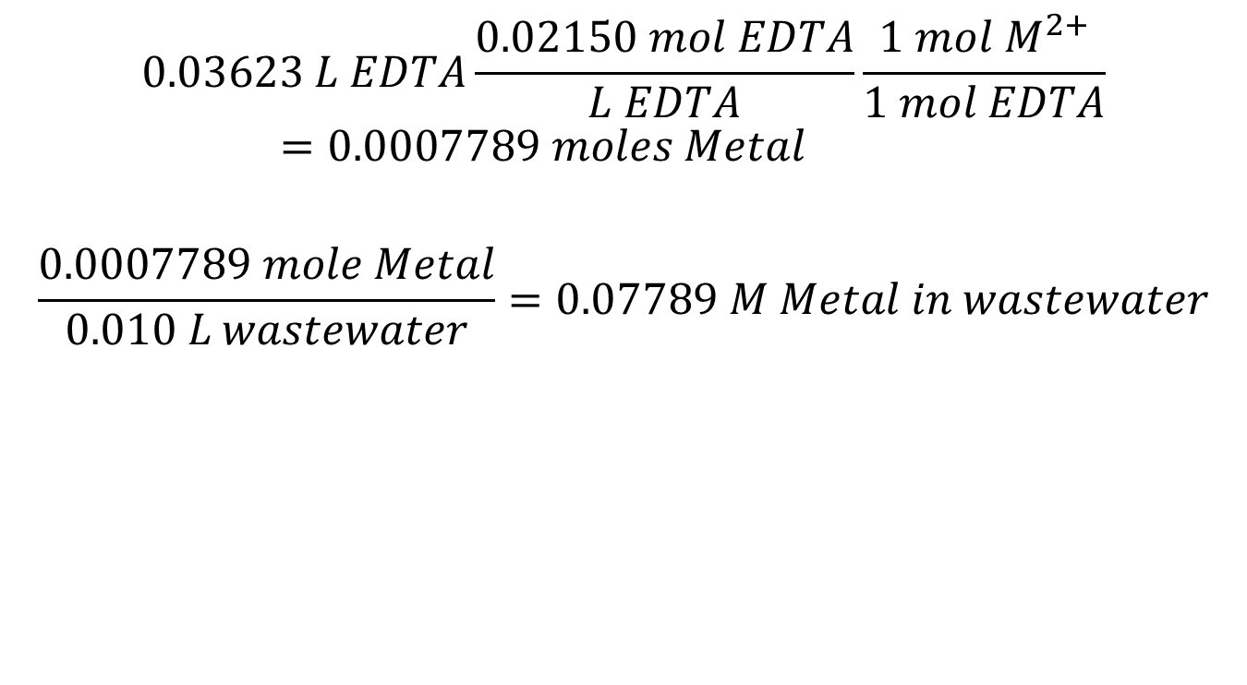
If you don’t like the algebraic way
$$0.03623 L EDTA\frac{0.02150 mol EDTA}{L EDTA}\frac{1 mol M^{2+}}{1 mol EDTA}=0.0007789 moles Metal$$
$$\frac{0.0007789 mole Metal}{0.010 L wastewater}=0.07789 M Metal in wastewater$$

Slide 39
Why 10.00 mL and not 50.00 mL?
Dilution does not change the amount of anything present!
1 L of water + 100 grams of sugar
Add another L of water

Slide 40
Why 10.00 mL and not 50.00 mL?
100 grams of sugar in both!
Concentration is different, but we don’t care. Why…? Because the diluted sample is NOT my waste water.

Slide 41
Reactions are between molecules
Reactions happen because 2 (or more) molecules stick together. It is only the number of molecules that count. Instead of 100 g of sugar, pretend I have 5 metal molecules.

Slide 42
Reactions are between molecules
If I react them with EDTA

Slide 43
Reactions are between molecules
5 metal ions react with 5 EDTA ions no matter how much water.

Slide 44
An example
10.00 mL of a waste water sample is dilute to 50 mL total volume. Titration with a 0.02150 M EDTA solution shows a Calmagite endpoint after addition of 36.23 mL. What is the total hardness of the water sample?
(10.00 mL) X = (36.23 mL) (0.02150 M)
X = 0.07789 M
Is Molarity a “good” unit? Molarity of what?

Slide 45
Depends on what you mean by good…
Hardness is usually expressed in mg/L of CaCO₃ equivalents.
$$\frac{mg CaCO_{3}equivalents}{L of solution}$$
Since, in this case, all the metals are lumped together, they are taken to be “Ca²⁺ equivalents”

Slide 46
0.07789 mol Ca²⁺ * 1 mol CaCO₃ * 100.09 g CaCO₃ * 10³ mg = 7796 mg/L
L solution 1 mol Ca²⁺ 1 mol CaCO₃ g
“7796 mg/L as CaCO₃” would be how you would express this number.
NOTE: There may be no Calcium carbonate in the sample at all!!! But we are expressing it as an equivalence.

Slide 47
Analytical Methods
You can also determine metal concentrations using advanced instrumentation like “atomic absorption spectroscopy” (AAS) and “inductively coupled plasma” (ICP).

Slide 48
Determining Ca and Mg separately
With advanced techniques (other than EDTA titration), you can determine the Ca²⁺ and Mg²⁺ concentrations separately. These could be reported separately, or they could be combined into CaCO₃ equivalents.

Slide 49
Sample problem
AAS analysis of a water sample determined the Ca²⁺ hardness to be 36 mg/L and the Mg²⁺ hardness to be 16 mg/L. What is the total hardness expressed as CaCO₃ equivalents?

Slide 50
Units! Units! Units!
This is really just a unit conversion problem. You need to recognize the stoichiometry is 1:1.
MgCO₃
CaCO₃
There is 1 metal ion for each carbonate ion.

Slide 51
36 mg Ca²⁺ * 1 g * 1 mol Ca²⁺ * 1 mol CaCO₃ *100.1 g CaCO₃ * 10³ mg =
1 L 10³ mg 40.1 g Ca²⁺ 1 mol Ca²⁺ 1 mol CaCO₃ 1 g
= 90 mg/L as CaCO₃
Similarly for Mg:
16 mg Mg²⁺ * 1 mmol Mg * 1 mmol Ca²⁺ * 1 mmol CaCO₃ *100.1 mg CaCO₃ =
1 L 24.3 mg Mg²⁺ 1 mmol Mg²⁺ 1 mmol Ca²⁼ 1 mmol CaCO₃
= 66 mg/L as CaCO₃
Total hardness as CaCO₃ = 90 mg/L + 66 mg/L = 156 mg/L

Slide 52
Notice it’s just the masses:
36 mg Ca²⁺ * 1 g * 1 mol Ca²⁺ * 1 mol CaCO₃ *100.1 g CaCO₃ * 10³ mg =
1 L 10³ mg 40.1 g Ca²⁺ 1 mol Ca²⁺ 1 mol CaCO₃ 1 g
= 90 mg/L as CaCO₃
Because the stoichiometry is 1:1, it’s just the ratio of the masses:
36 mg Ca²⁺ * 100.1 g CaCO₃ = 90 mg/L as CaCO₃
1 L 40.1 g Ca²⁺

Slide 53
Good old carbonate
You can also look at the hardness in terms of the anions. In this case:
Total hardness = carbonate hardness + non-carbonate hardness
Carbonate includes both bicarbonate and carbonate. This is really alkalinity…they are kindred spirits!
Cation (Ca²⁺ et al) + anion (CO₃²⁻ et al) = CaCO₃
Hardness + alkalinity = CaCO₃

Slide 54
Why is carbonate special?
CO₂ – carbon dioxide from the air
CaCO₃ - limestone

Slide 55
Carbonate is singled out because…
…it’s nasty!
Bicarbonate hardness:
Ca²⁺_{(aq)}+ 2 HCO₃⁻_{(aq)} → CaCO_{3 (s)} + CO_{2 (g)} + H₂O_{(l)}
Bicarbonate hardness in the presence of softeners!:
Ca²⁺_{(aq)}+ 2 HCO₃⁻_{(aq)} + Ca(OH)_{2 (s)} → 2 CaCO_{3 (s)} + 2 H₂O_{(l)}

Slide 56
When CaCO₃ is not CaCO₃…
NOTE that both hardness and alkalinity are measured in CaCO₃ equivalents…but that doesn’t mean they will ever be the same number.
In one case, I’m looking at metals. In the other case, I’m looking at bases.

Slide 57
Consider…
I’ve got a total alkalinity of 100 mg CaCO₃/L.
What does that mean? It means that I’ve got enough base to neutralize the same amount of acid as 100 mg CaCO₃ in each liter of my waste water.
Suppose the actual species present is ammonia (NH₃).
The ammonia is NOT CaCO₃ and has no metal ion at all. So the total hardness might be 0 mg CaCO₃/L.

Slide 58
On the flip side…
Suppose I have a hardness that is 100 mg CaCO₃/L.
That means I have as much metal ions as 100 mg of CaCO₃ in each liter of waste water.
If the actual metal species present is Mg(NO₃)₂ there is NO base present.
The total alkalinity will be 0 mg CaCO₃/L!

